Slide 1


Slide 2
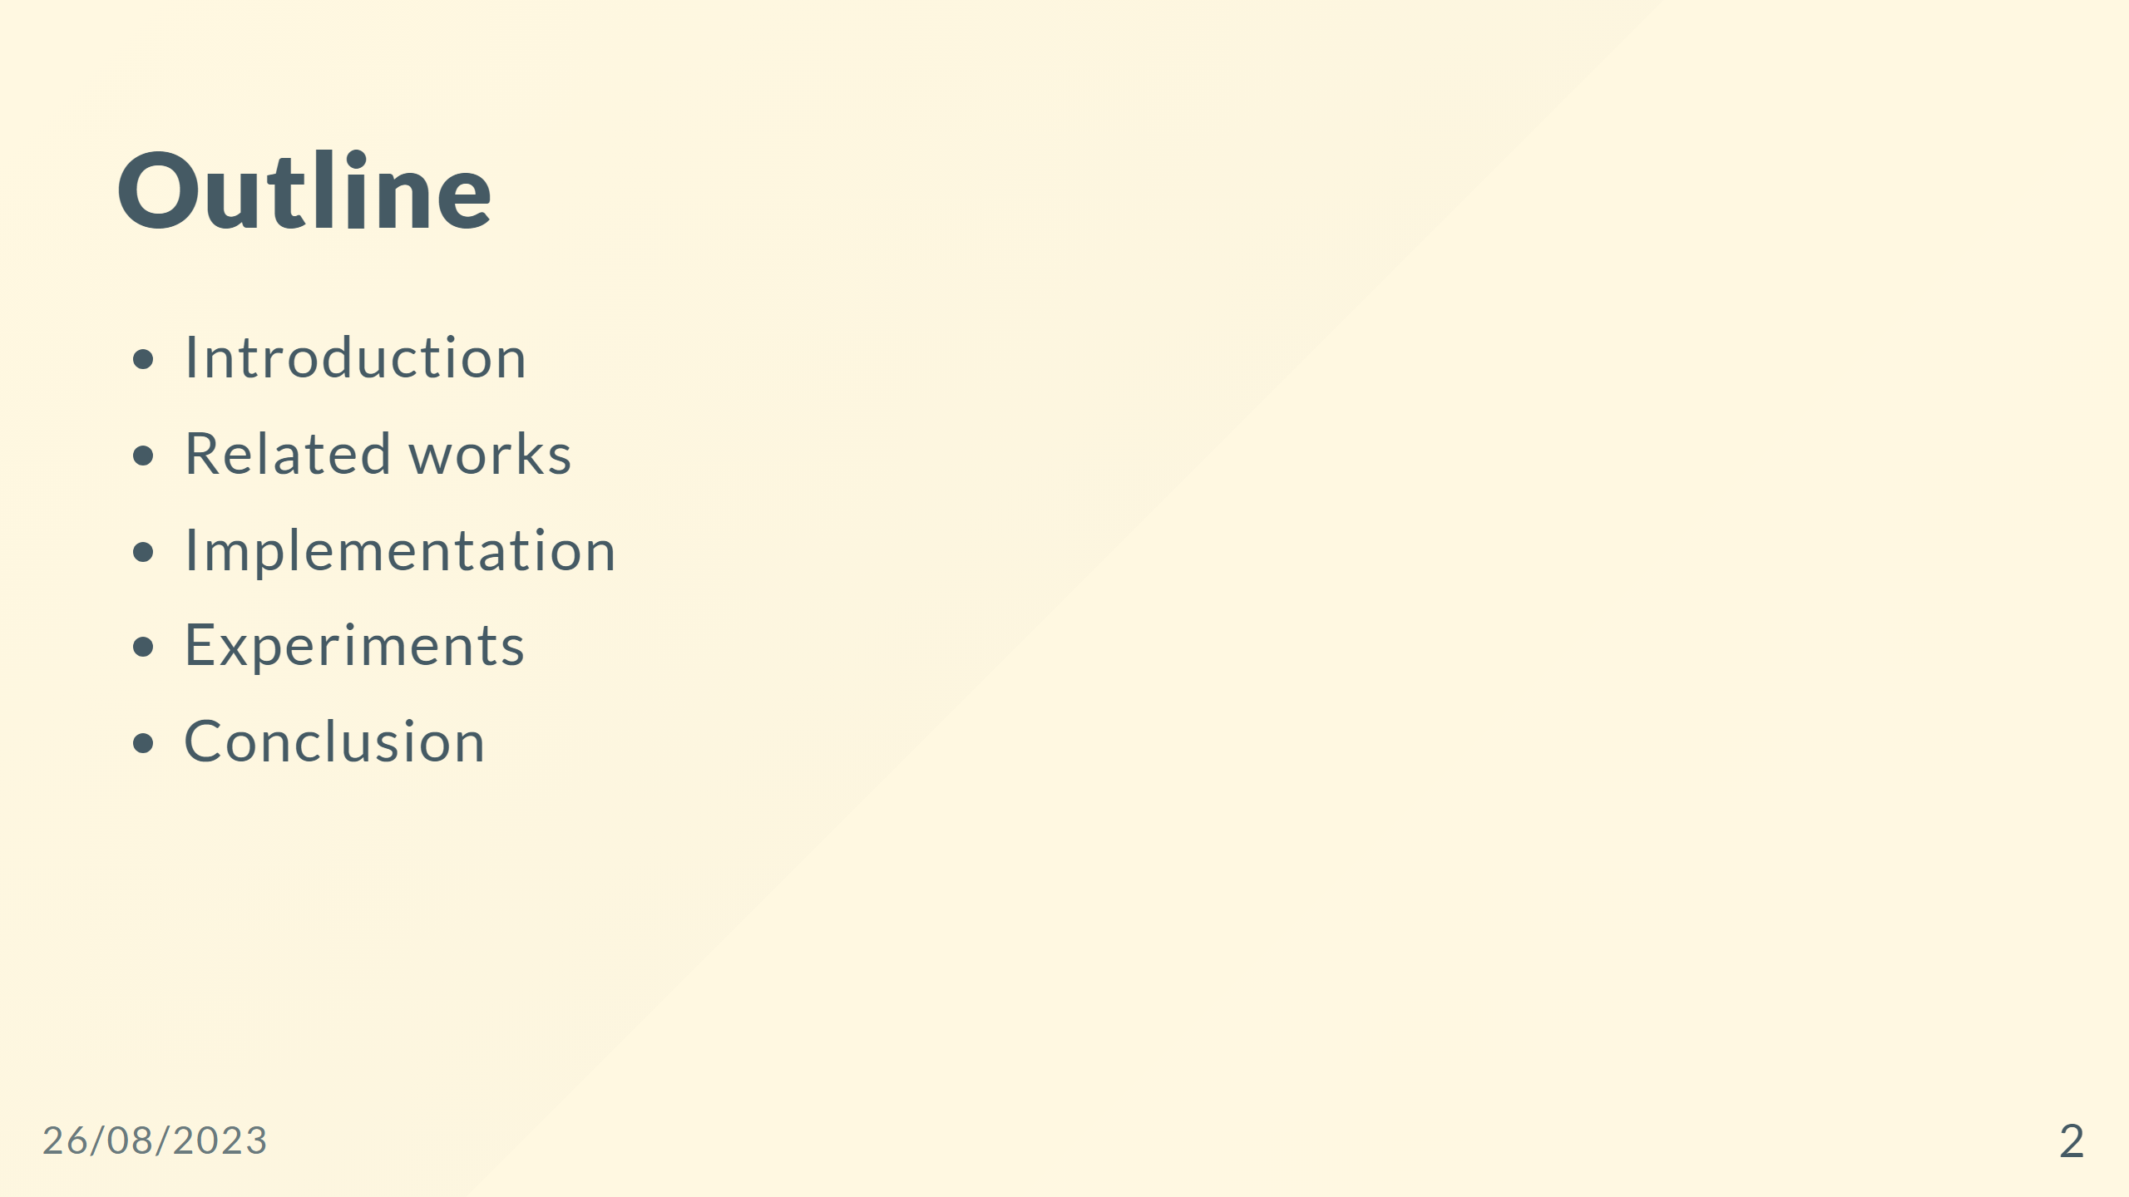

Slide 3


Slide 4
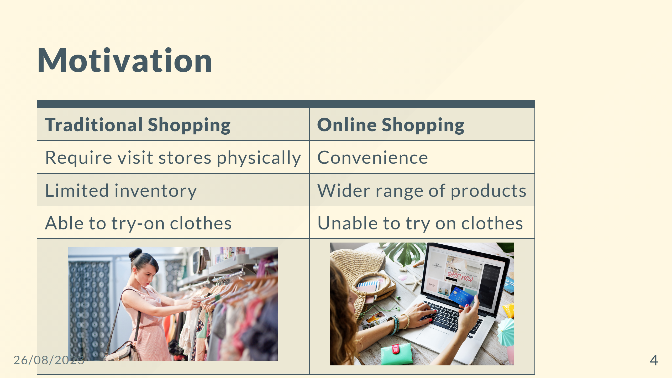

Slide 5
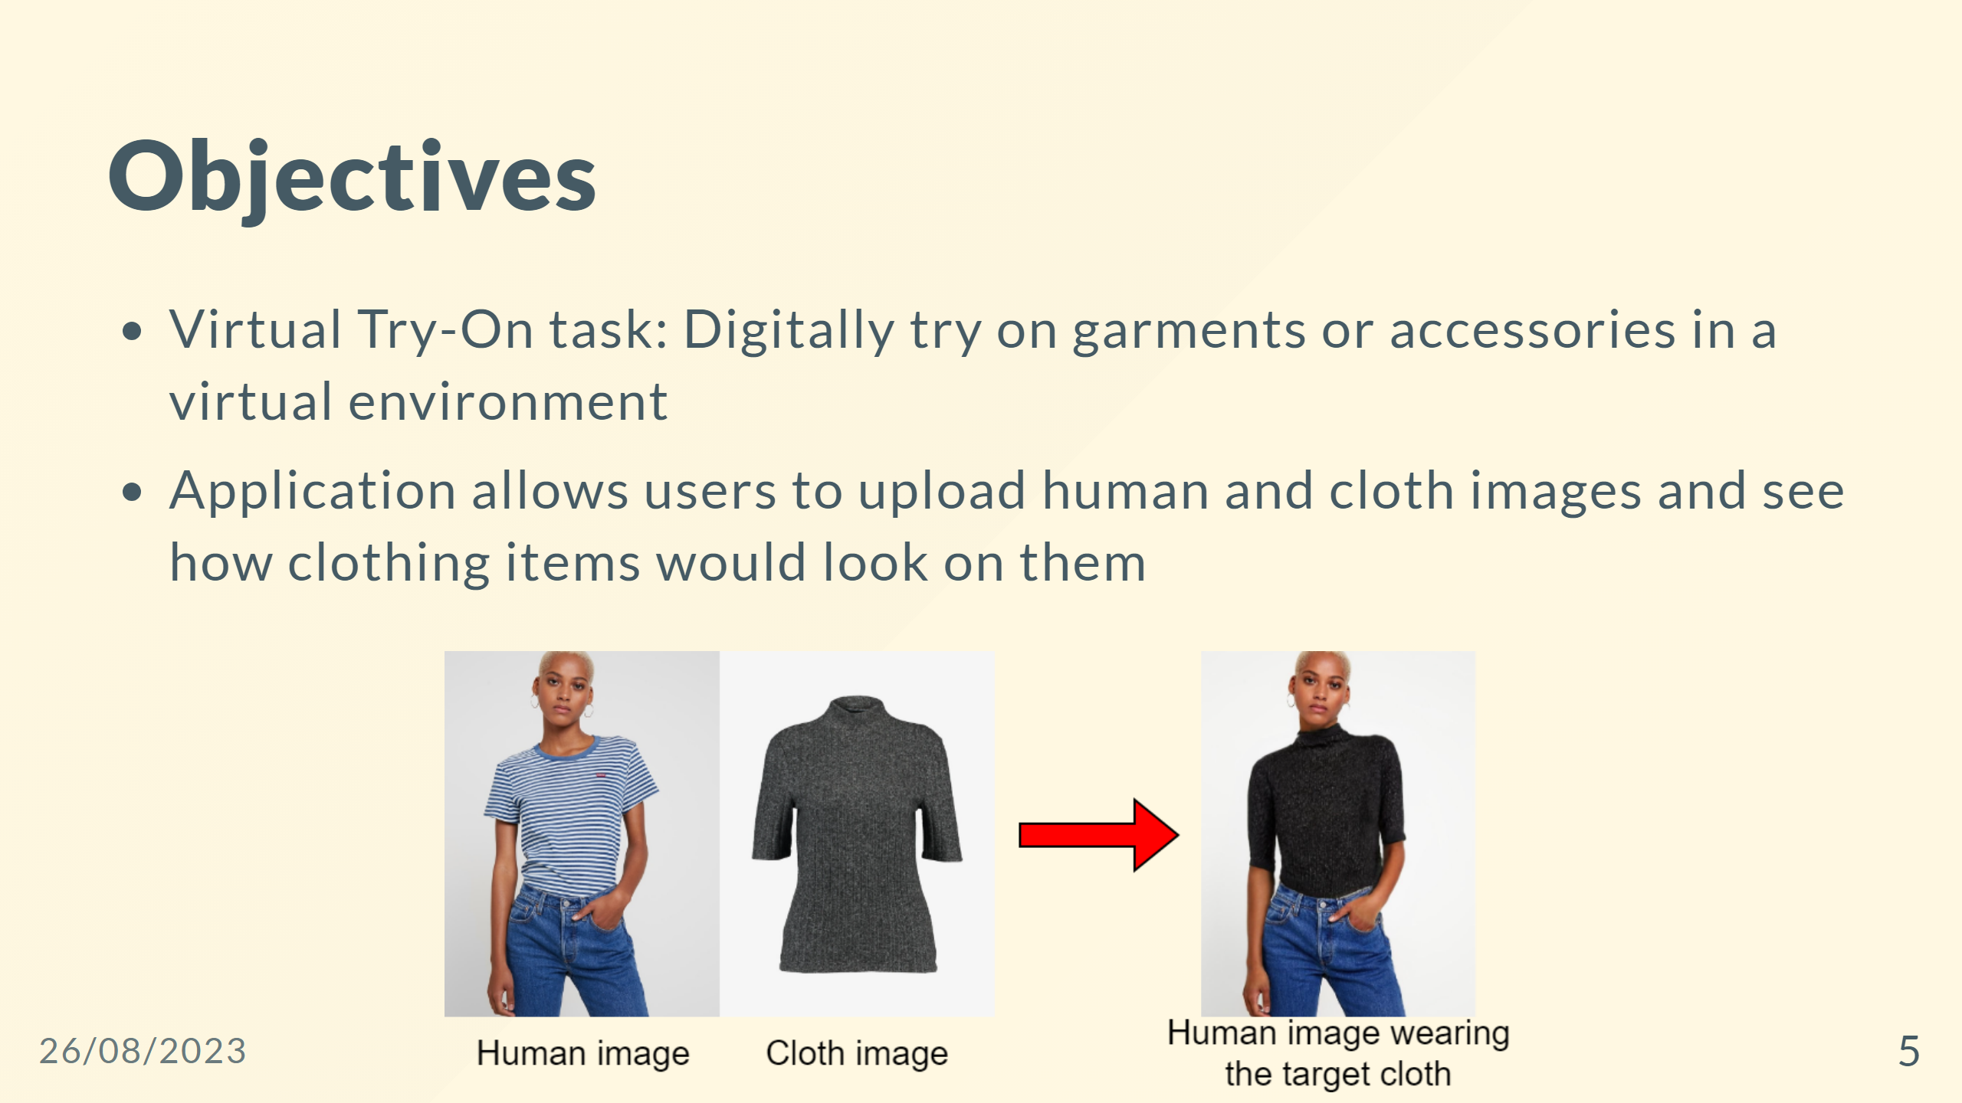

Slide 6


Slide 7
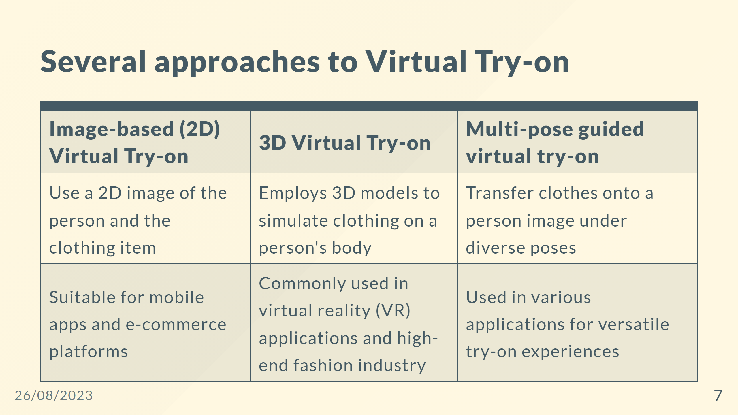
Notes:
- Virtual try-on with diffusion models

Slide 8
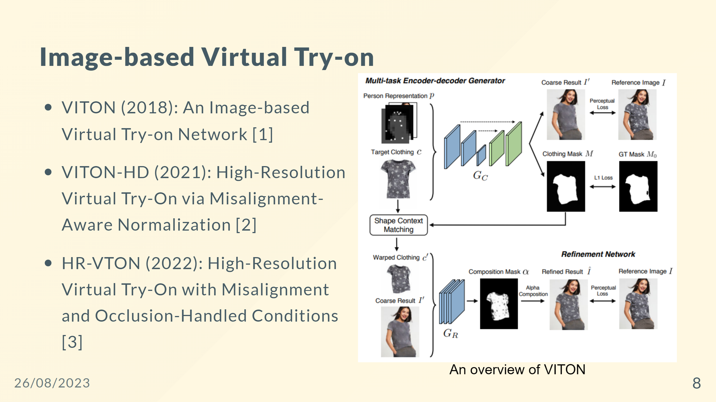

Slide 9
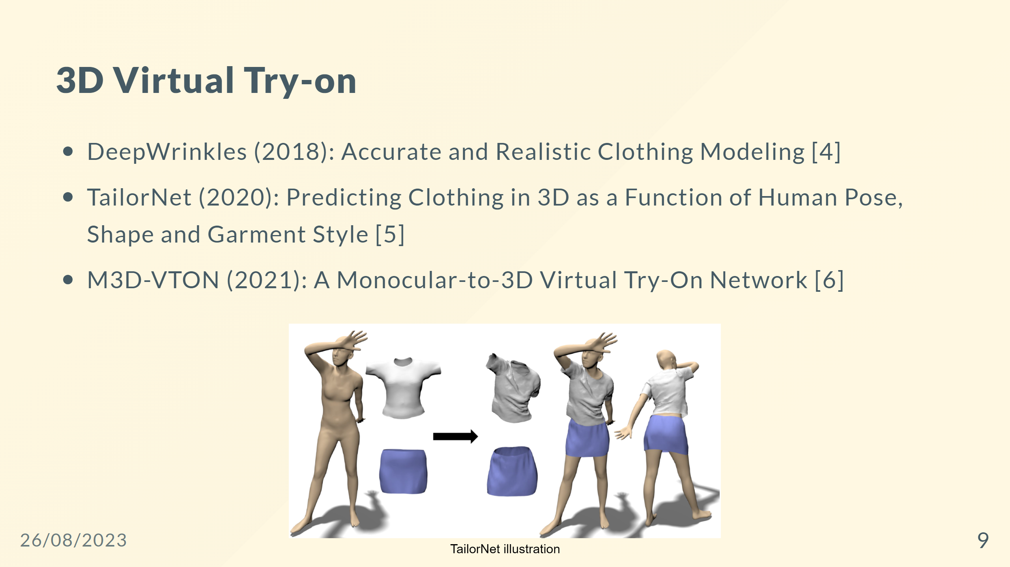

Slide 10
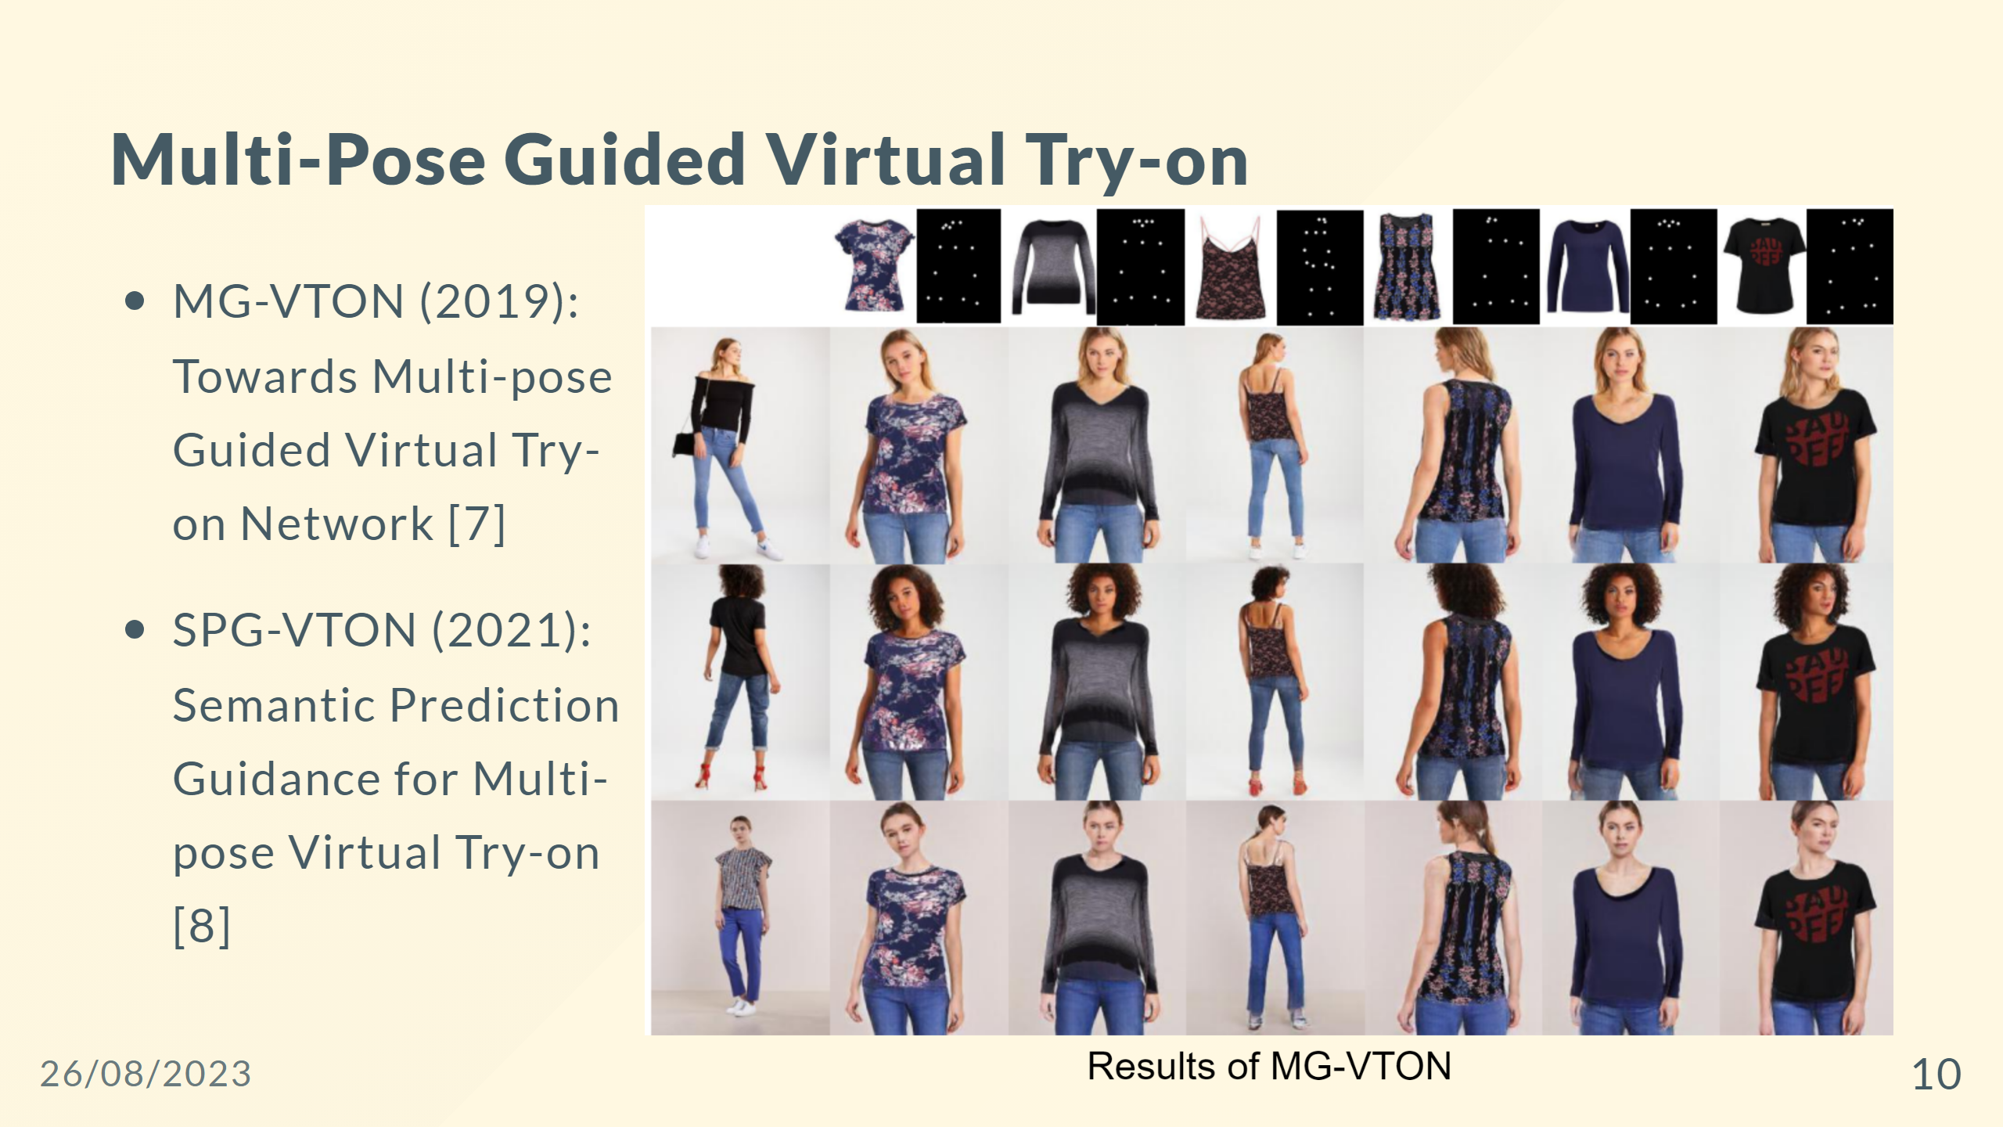

Slide 11
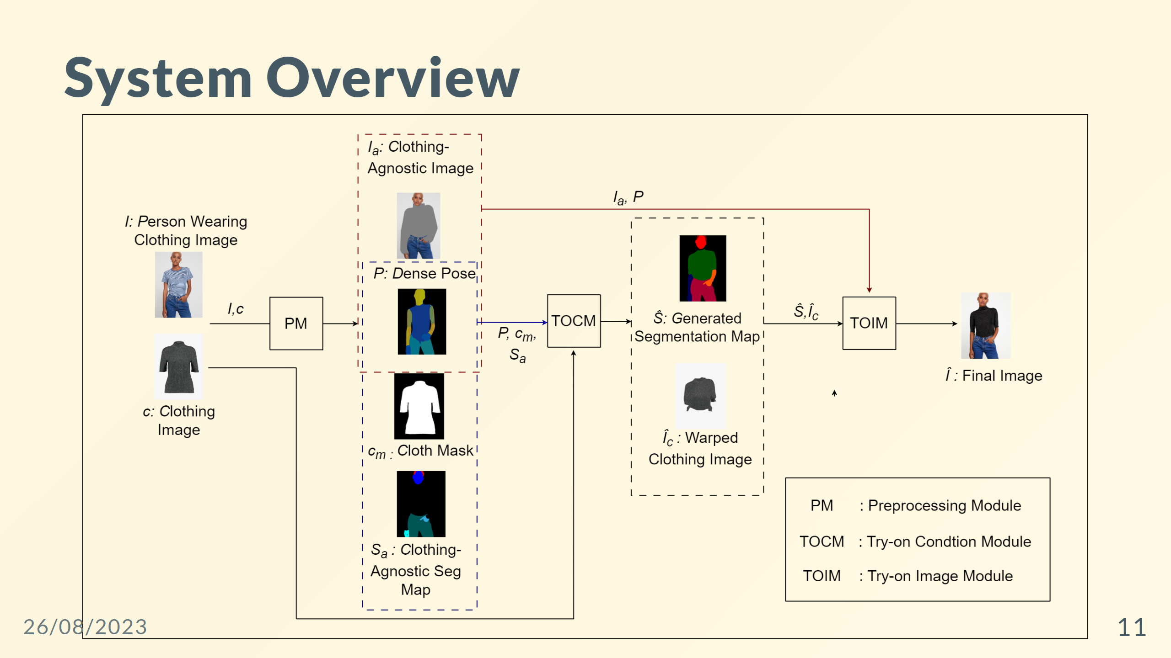
Notes:
--- ![width:850 centernotop](pre-processing_agnostic.png) <div style="color: black; font-size: 30px; margin-top: 30px; text-align: center; "> <b>Clothing-agnostic Processing Flow </b> </div>

Slide 12
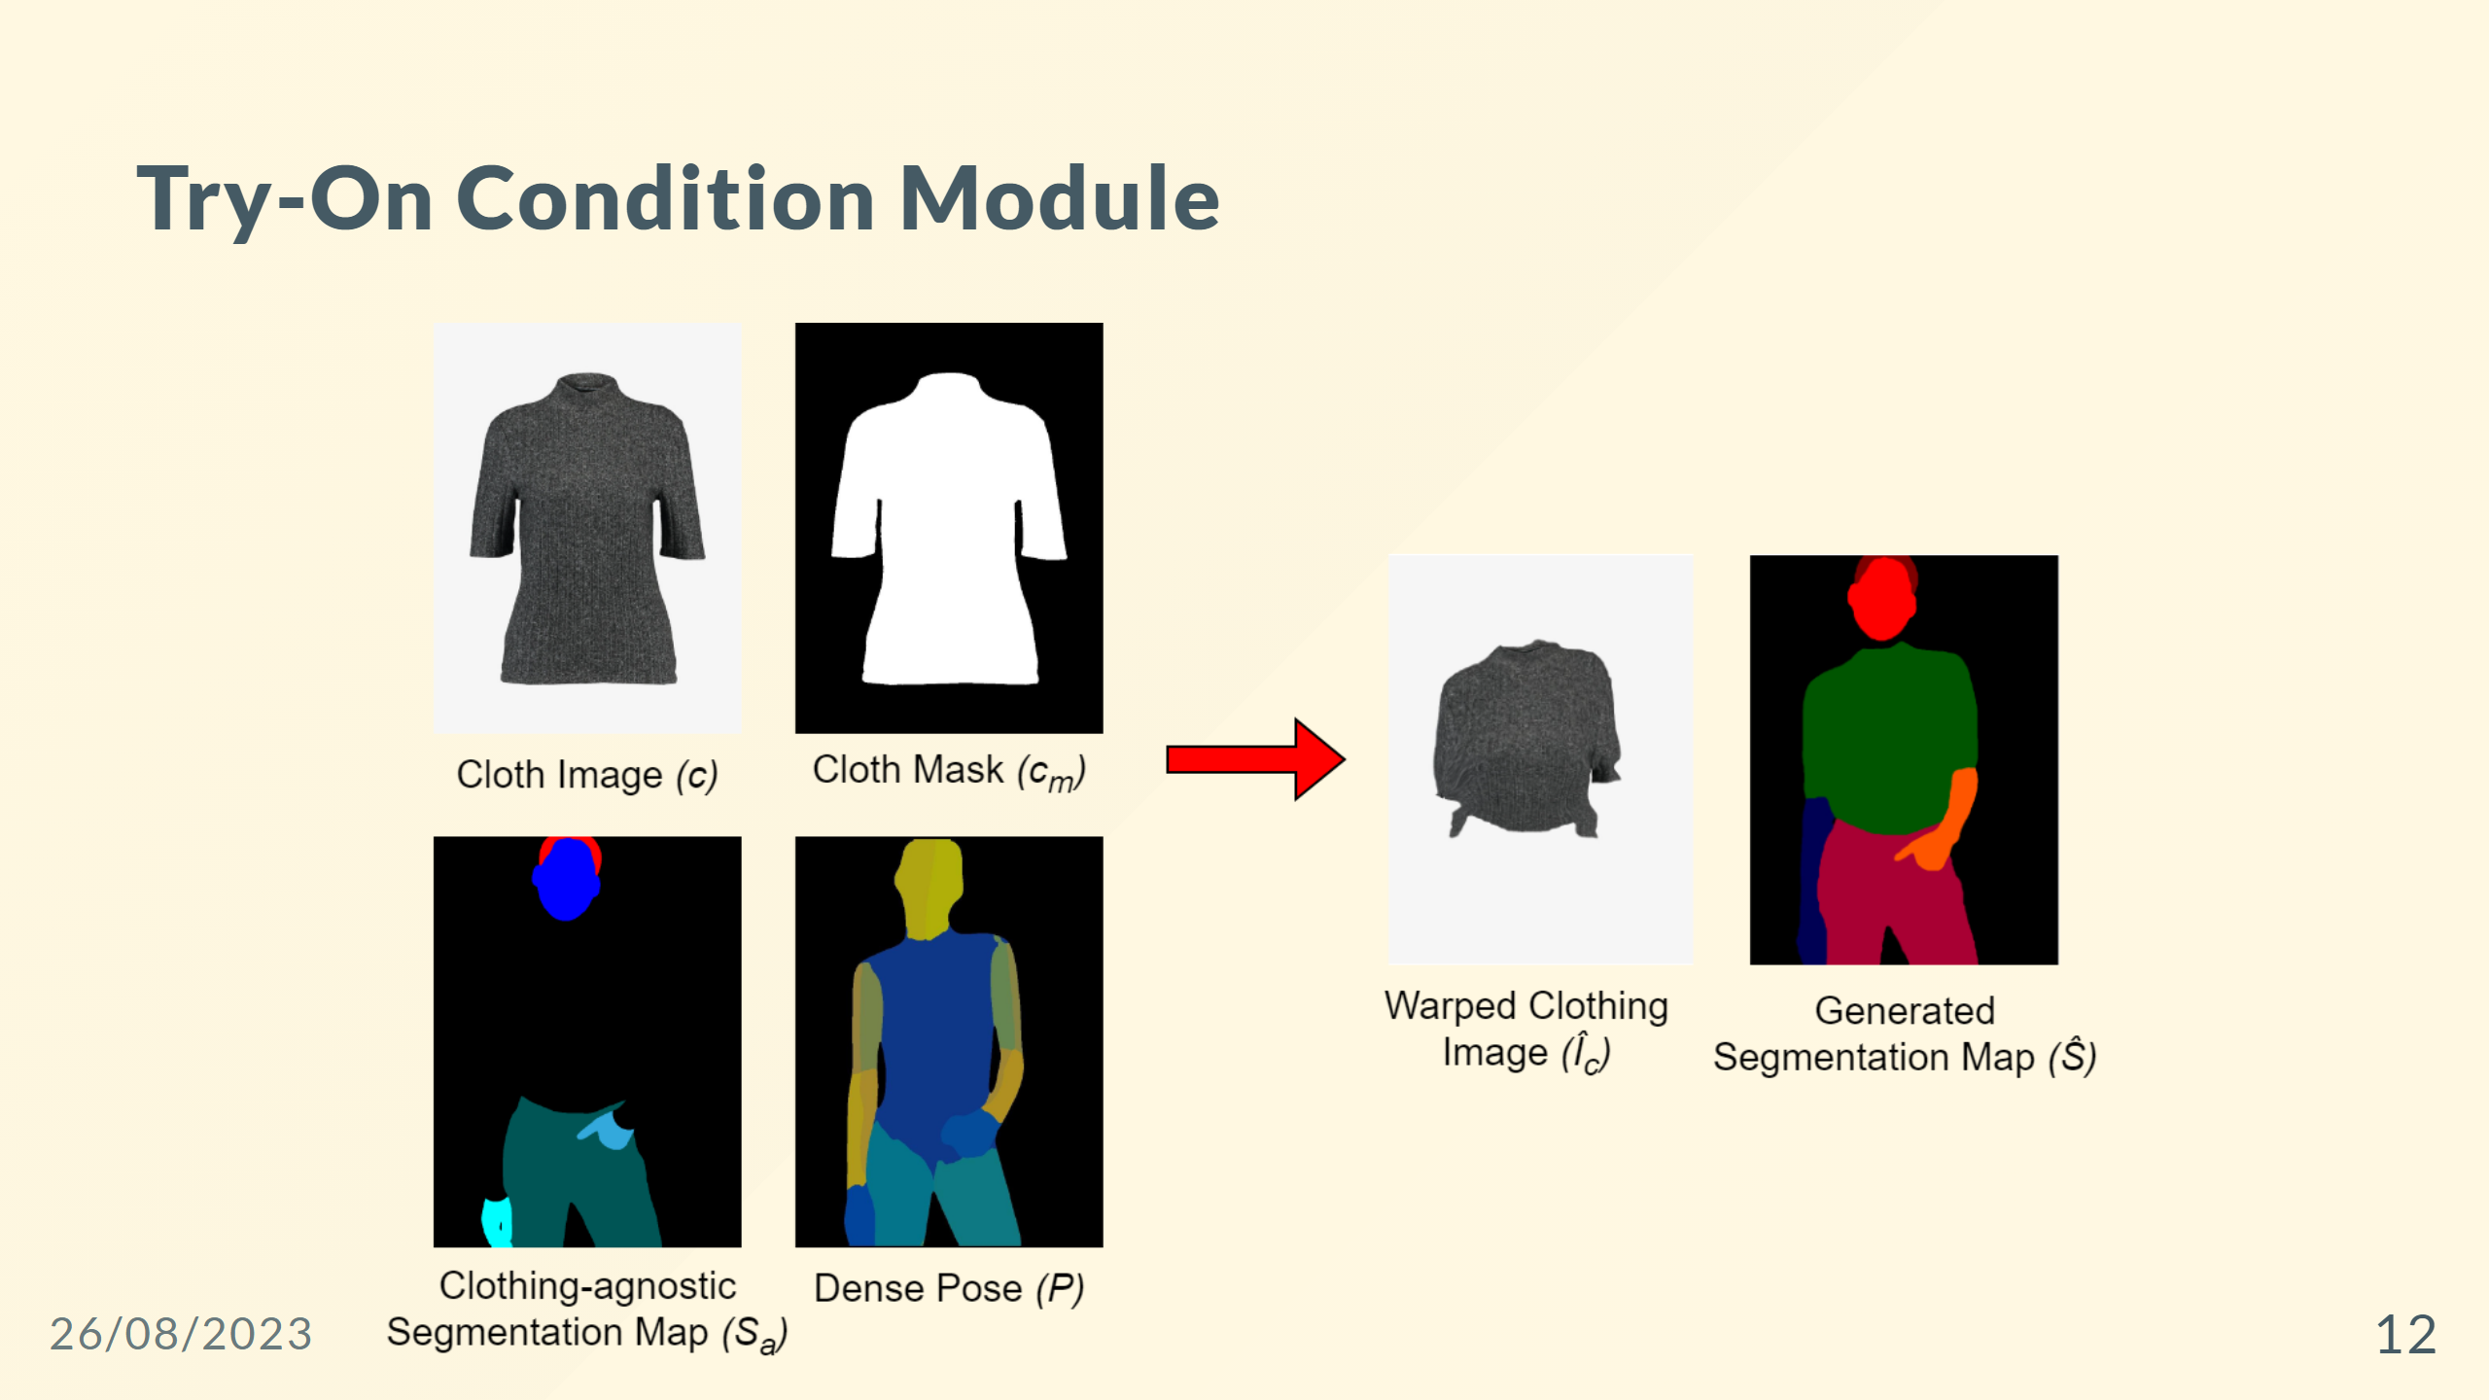

Slide 13
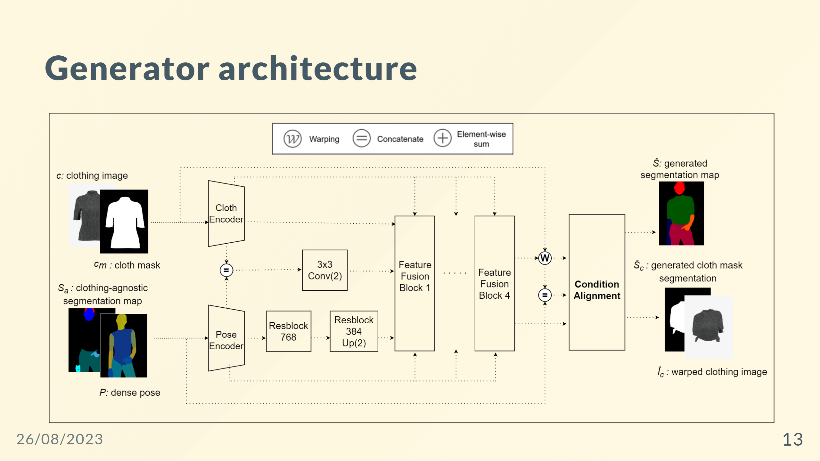
Notes:
<div style="color: white; font-size: 30px; margin-top: 150px; margin-left:700px "> <b>Generator Architecture</b> - Two encoders - Four feature fusion blocks - Condition Aligning stage </div>

Slide 14
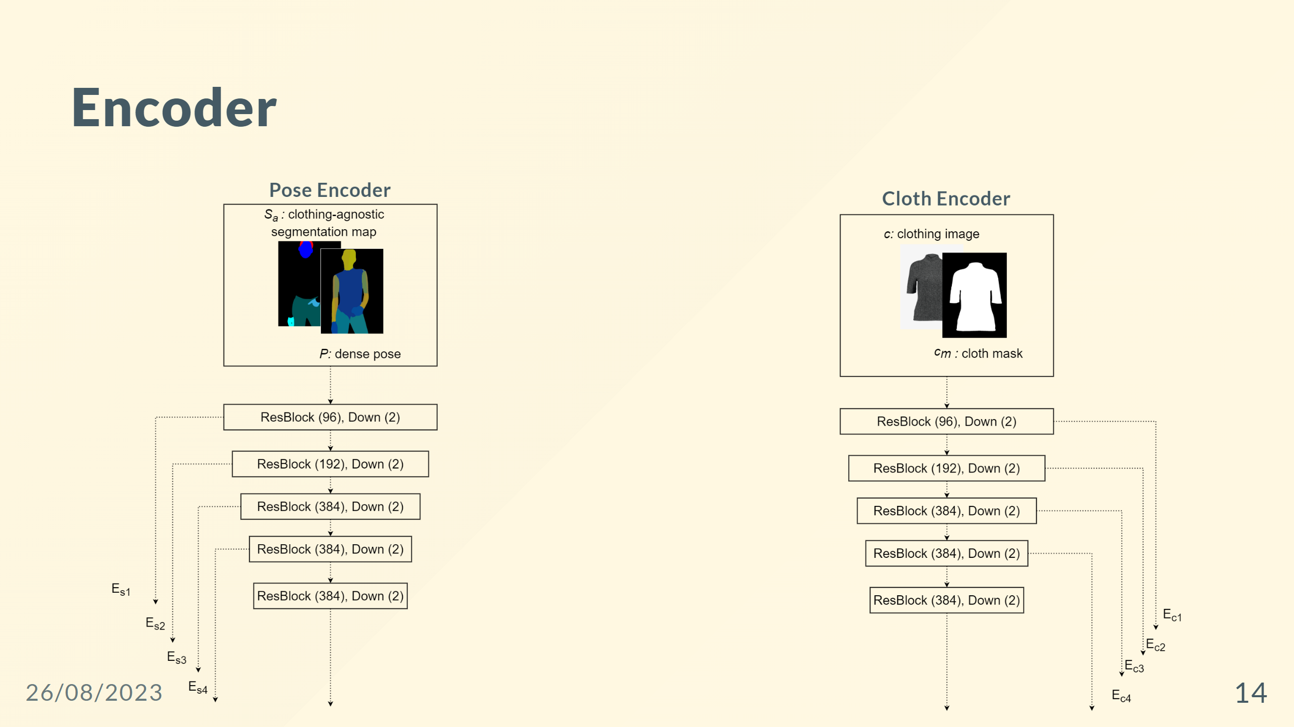

Slide 15
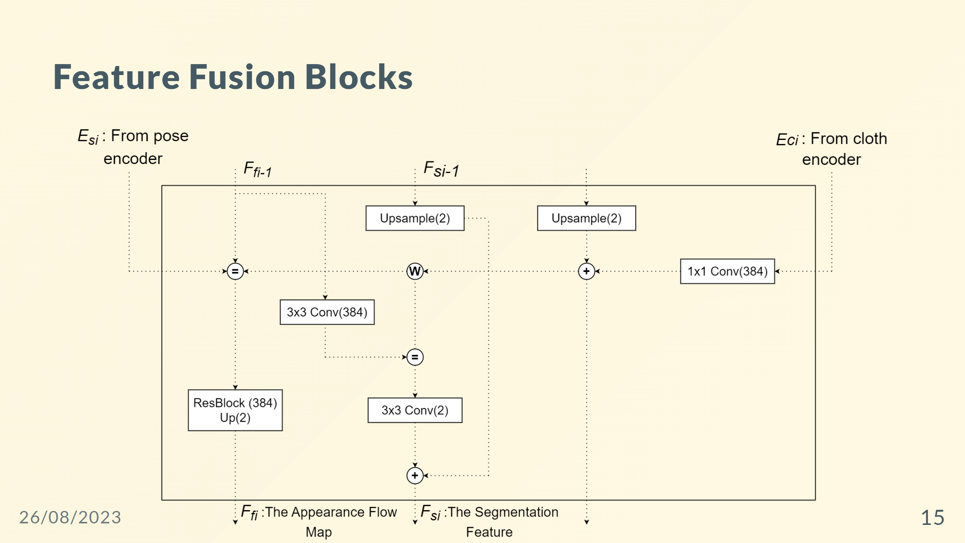
Notes:
- Has two routes: the flow pathway and the seg pathway. - Takes two inputs, $F_{f_{i-1}}$ and $F_{s_{i-1}}$. - The two pathways communicate with each other to determine $F_{f_i}$ and $F_{s_i}$ simultaneously.

Slide 16
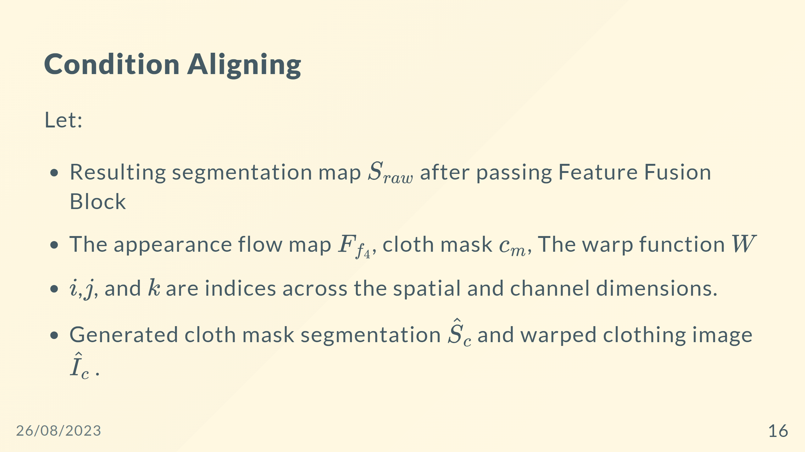

Slide 17
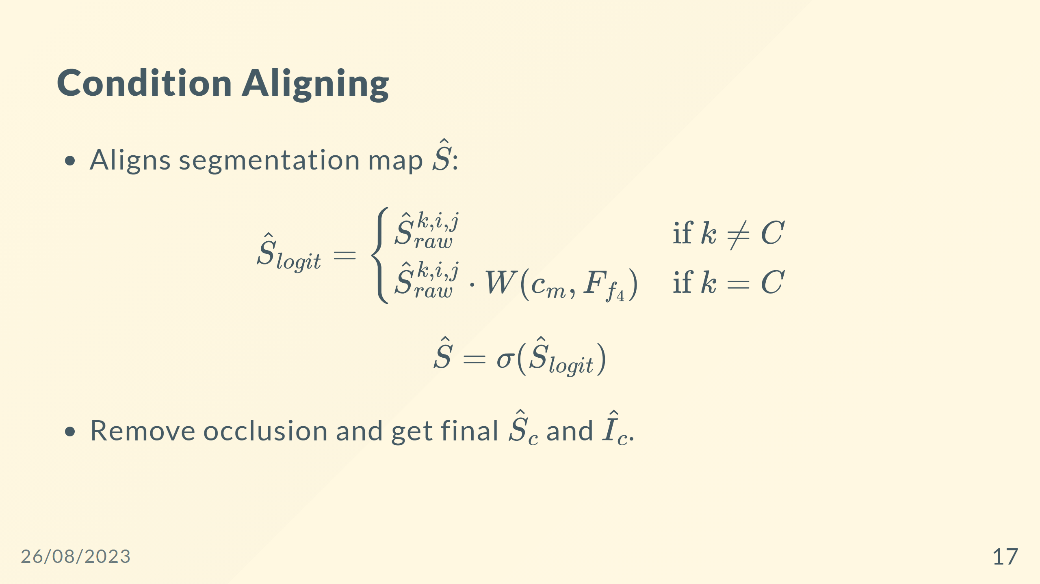

Slide 18
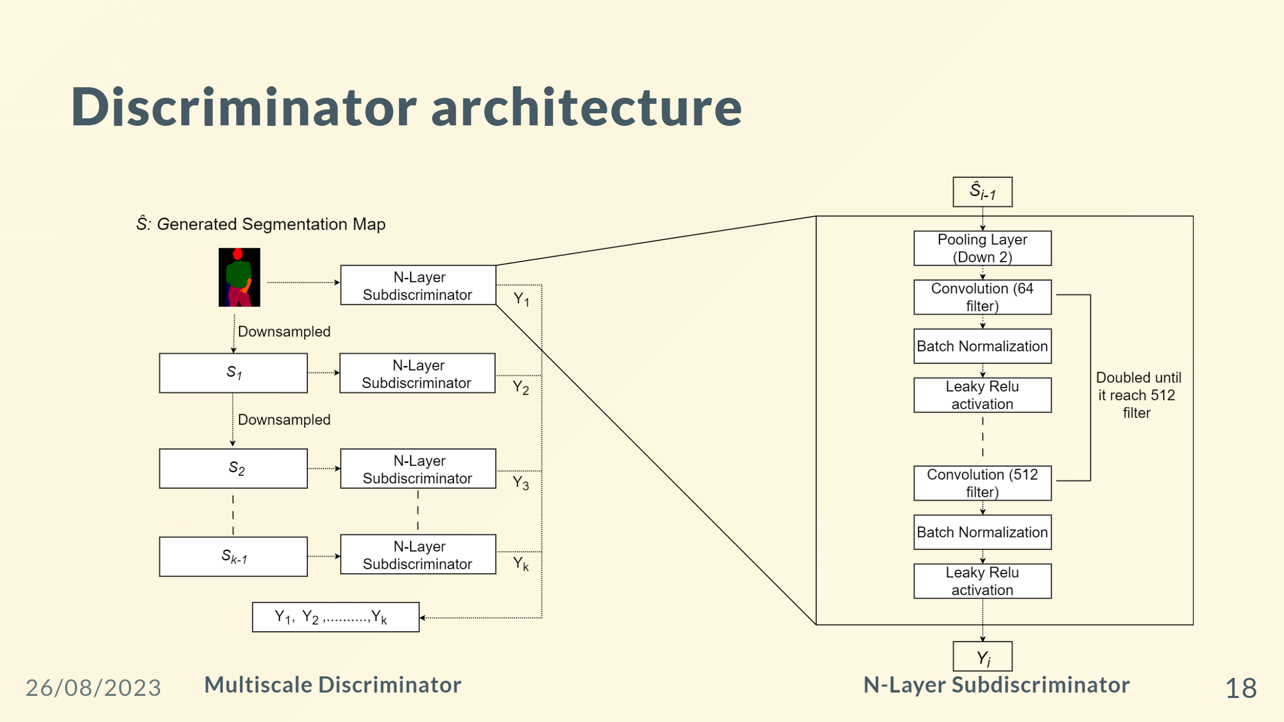
Notes:
![h:500 farRight](SubDiscriminator.png)

Slide 19
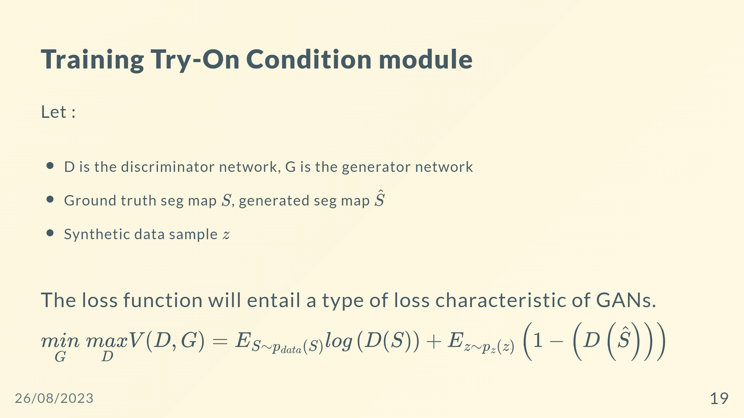

Slide 20
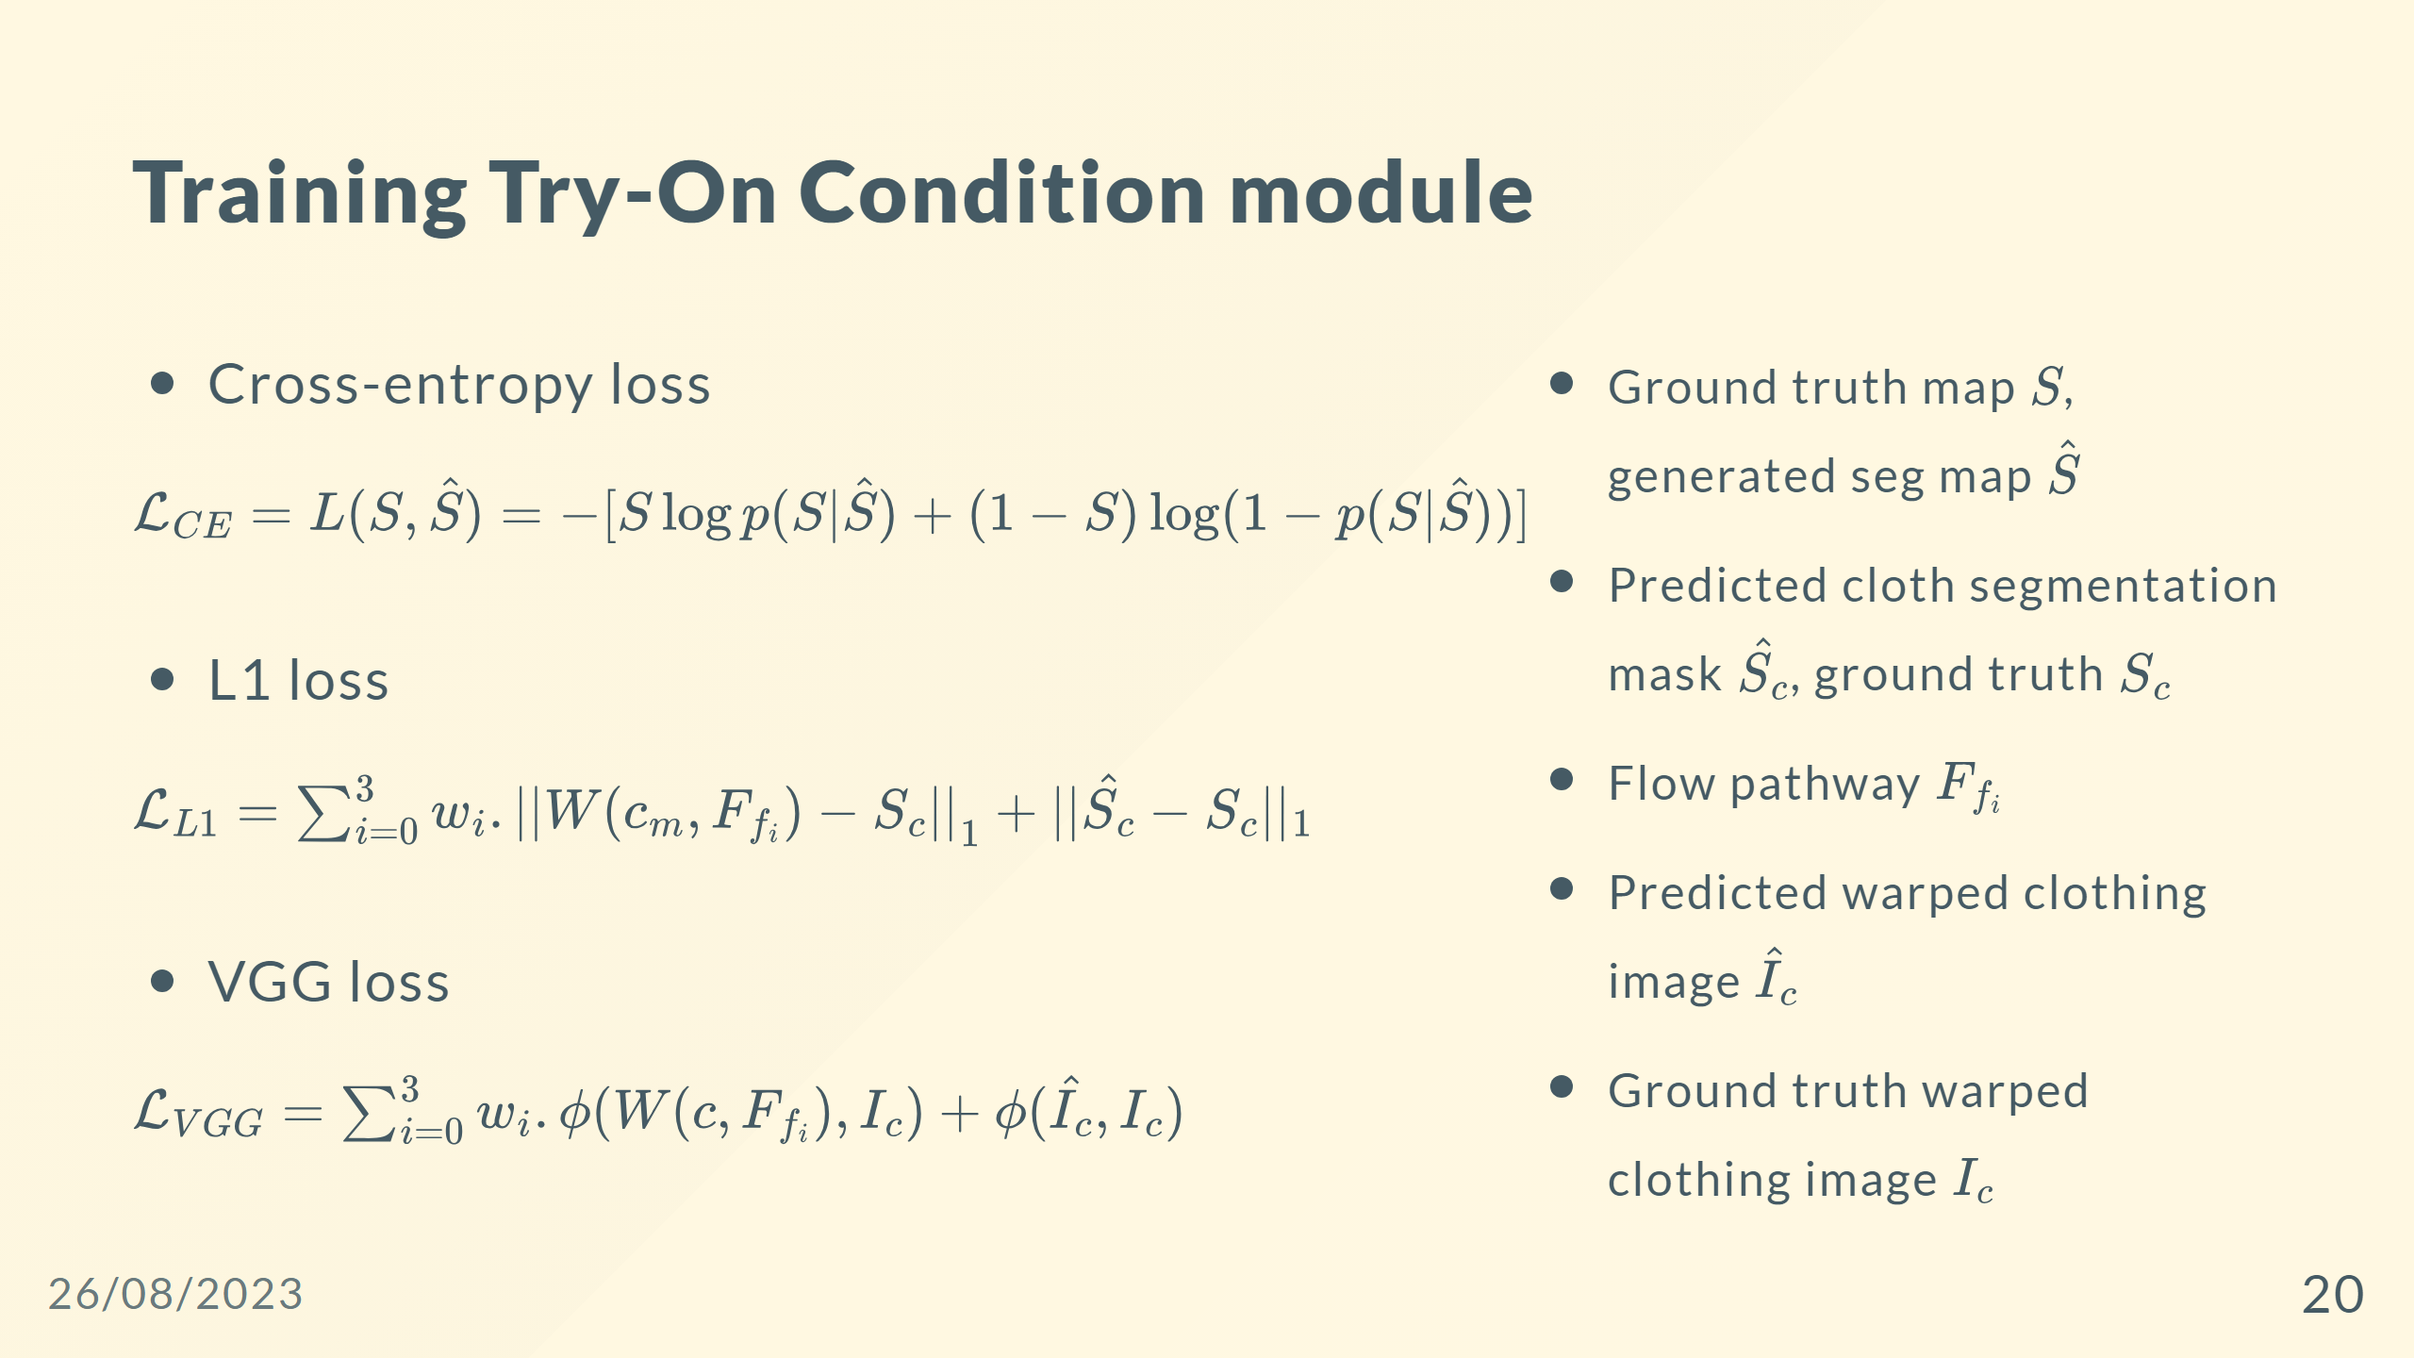

Slide 21
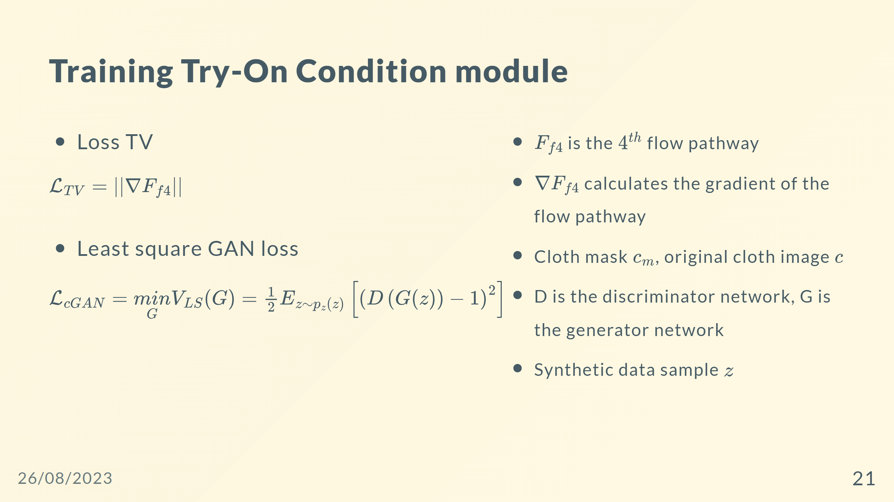

Slide 22
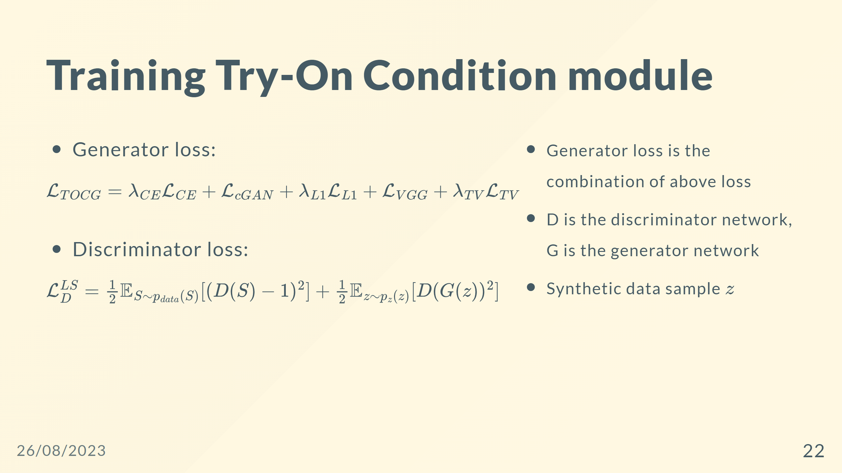

Slide 23
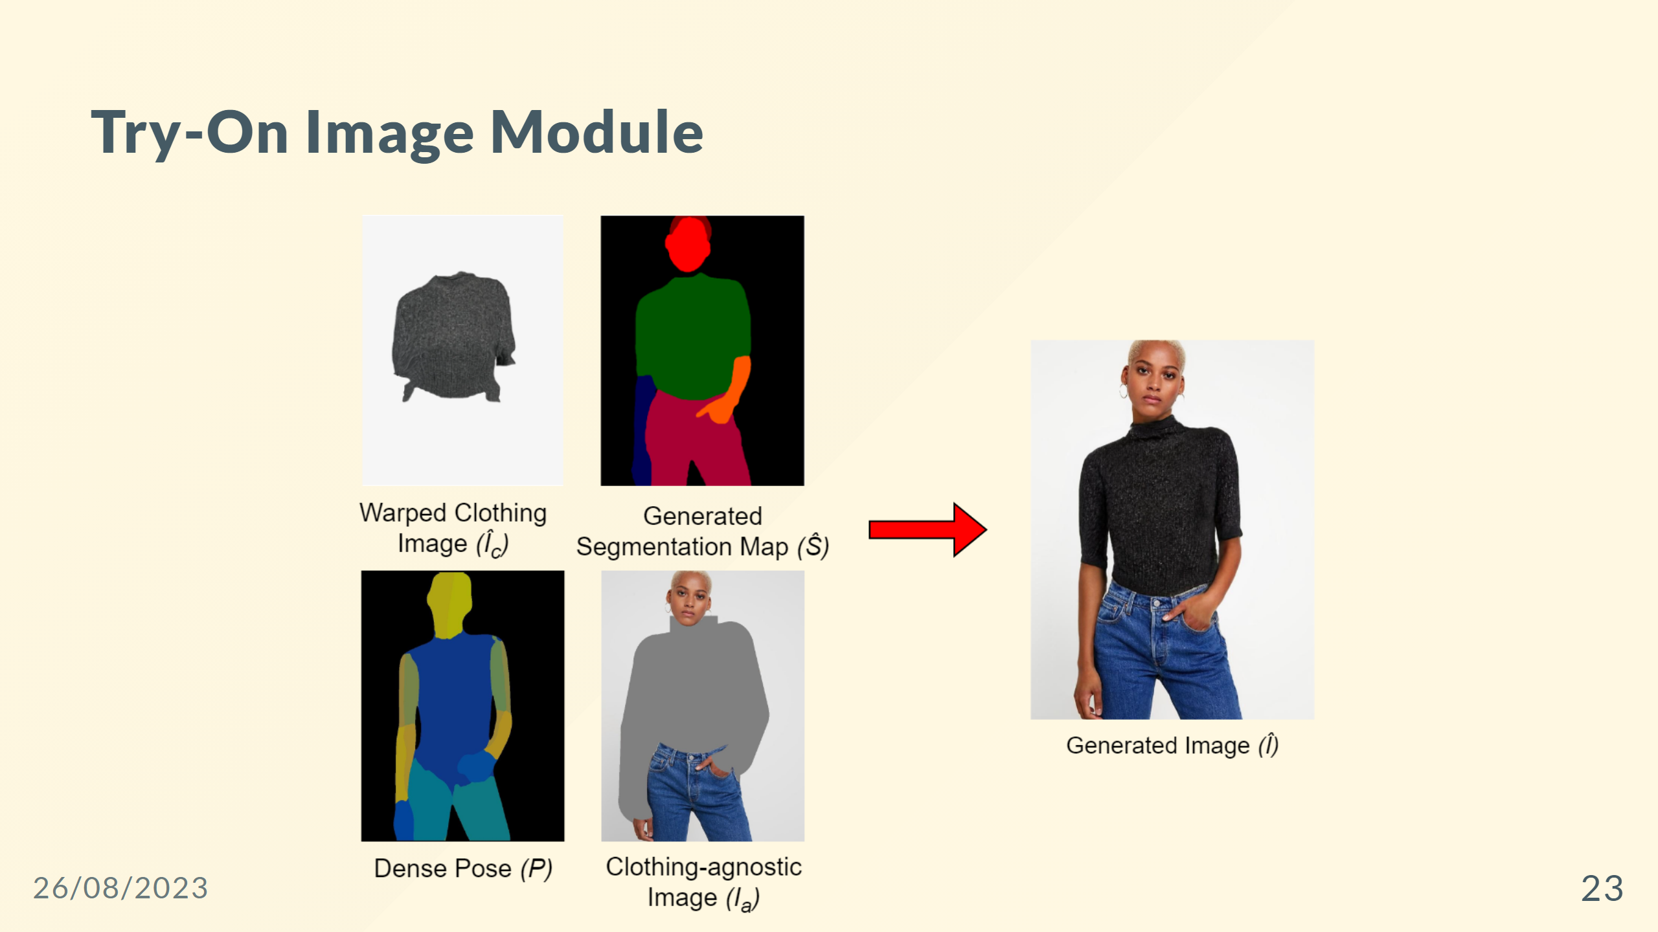

Slide 24
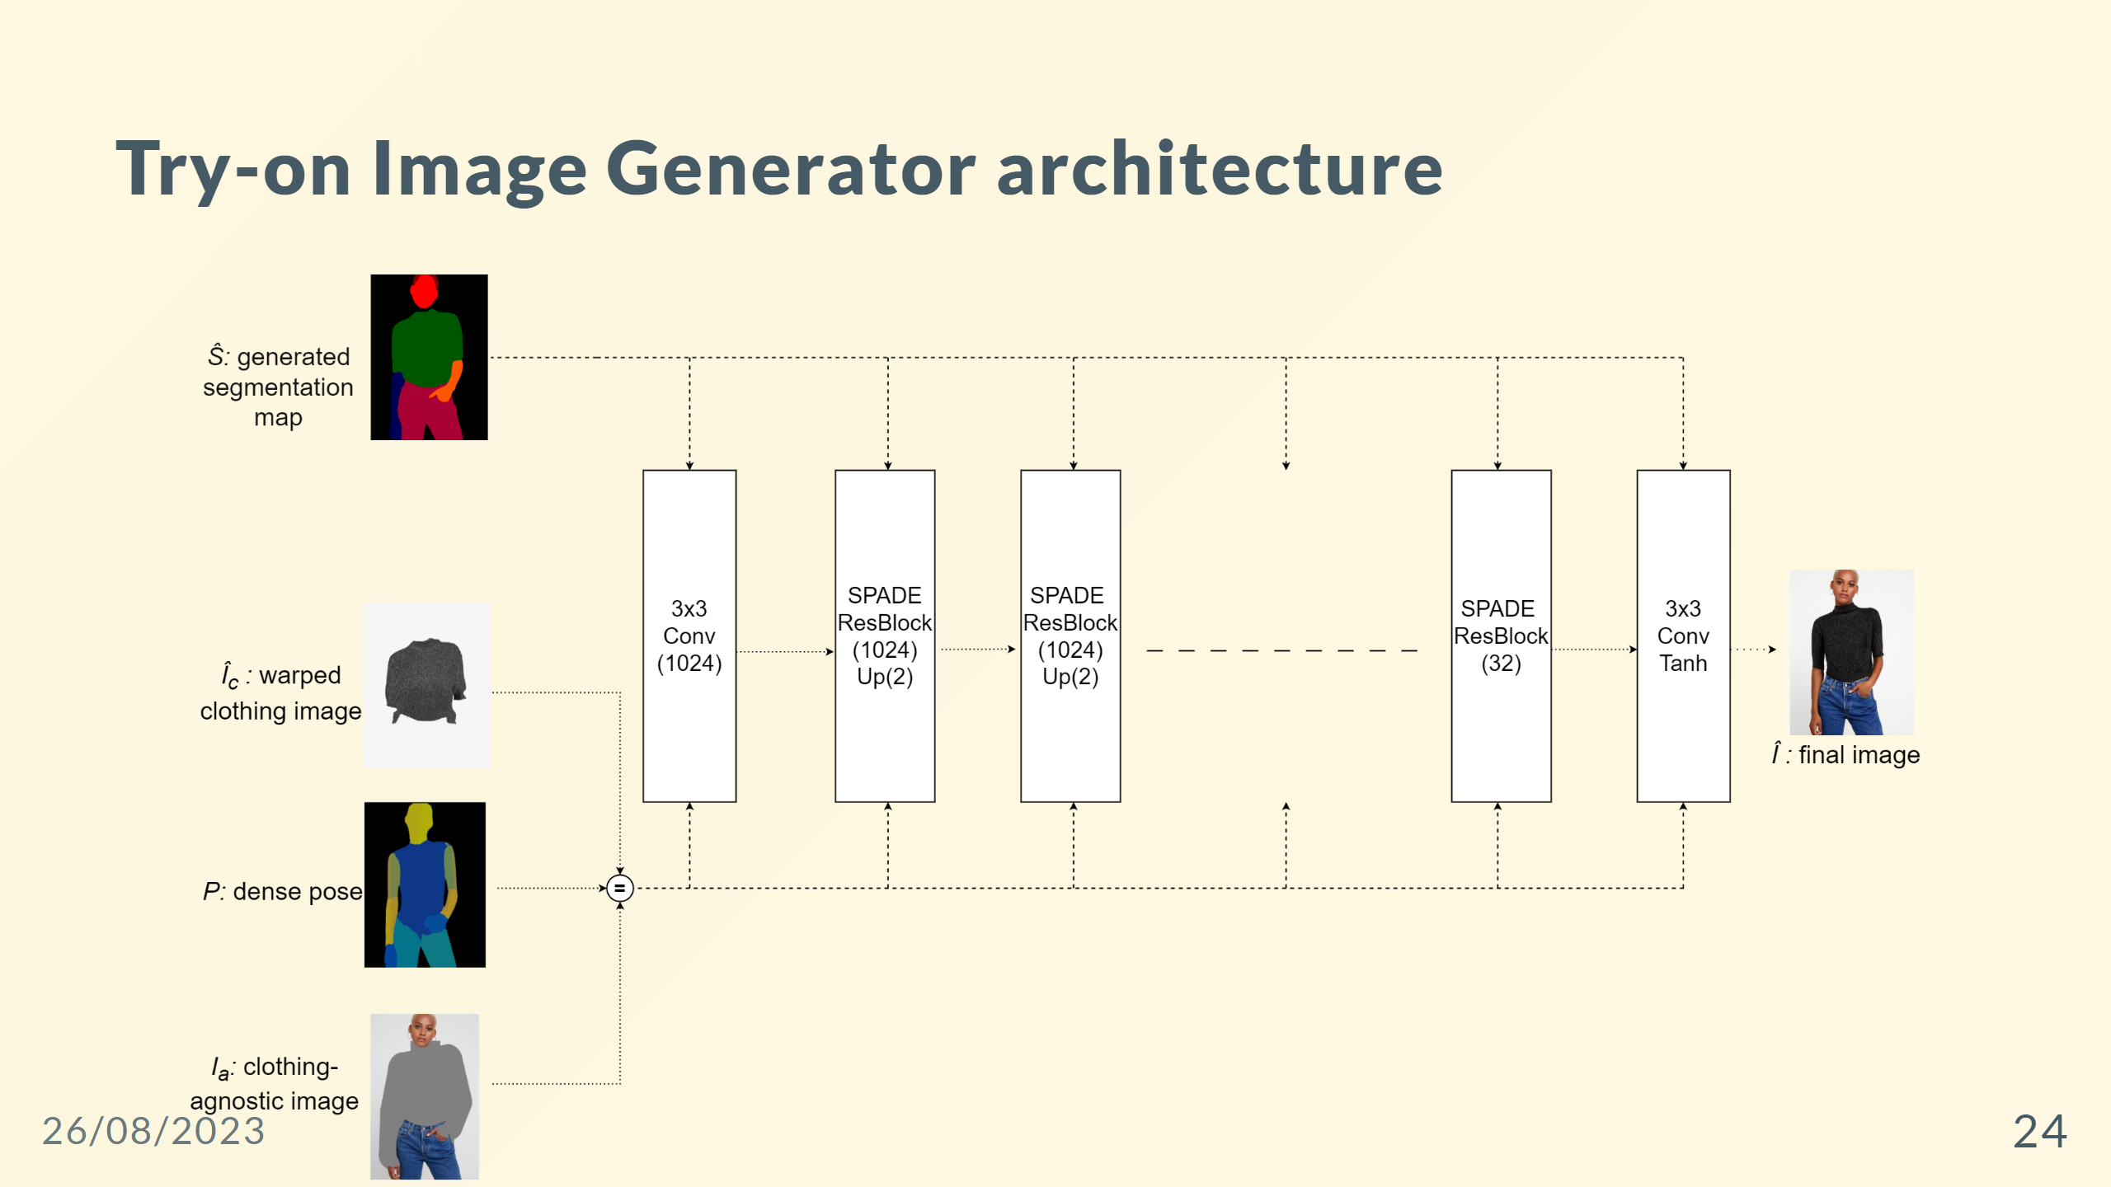

Slide 25
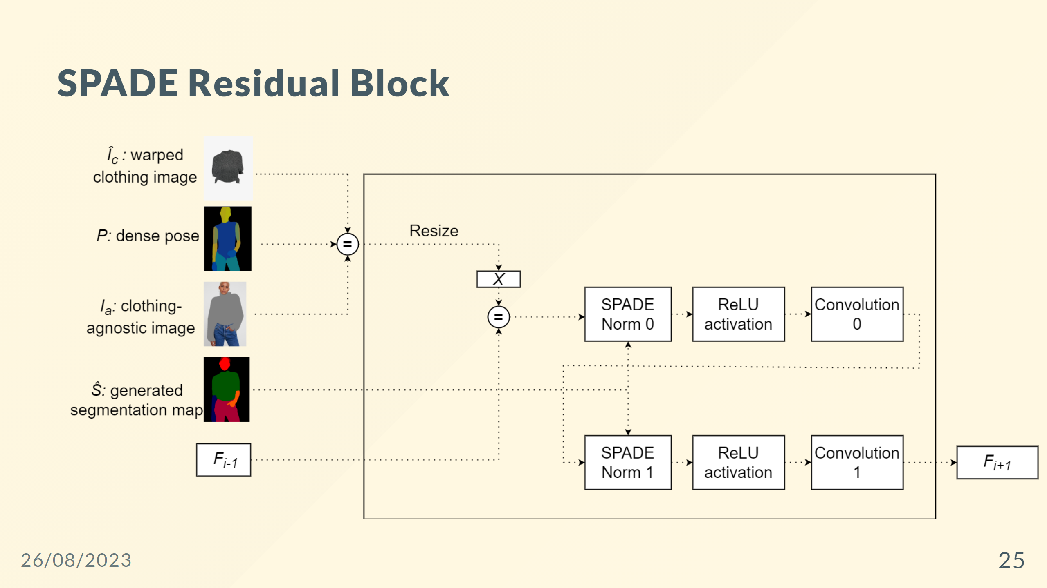

Slide 26
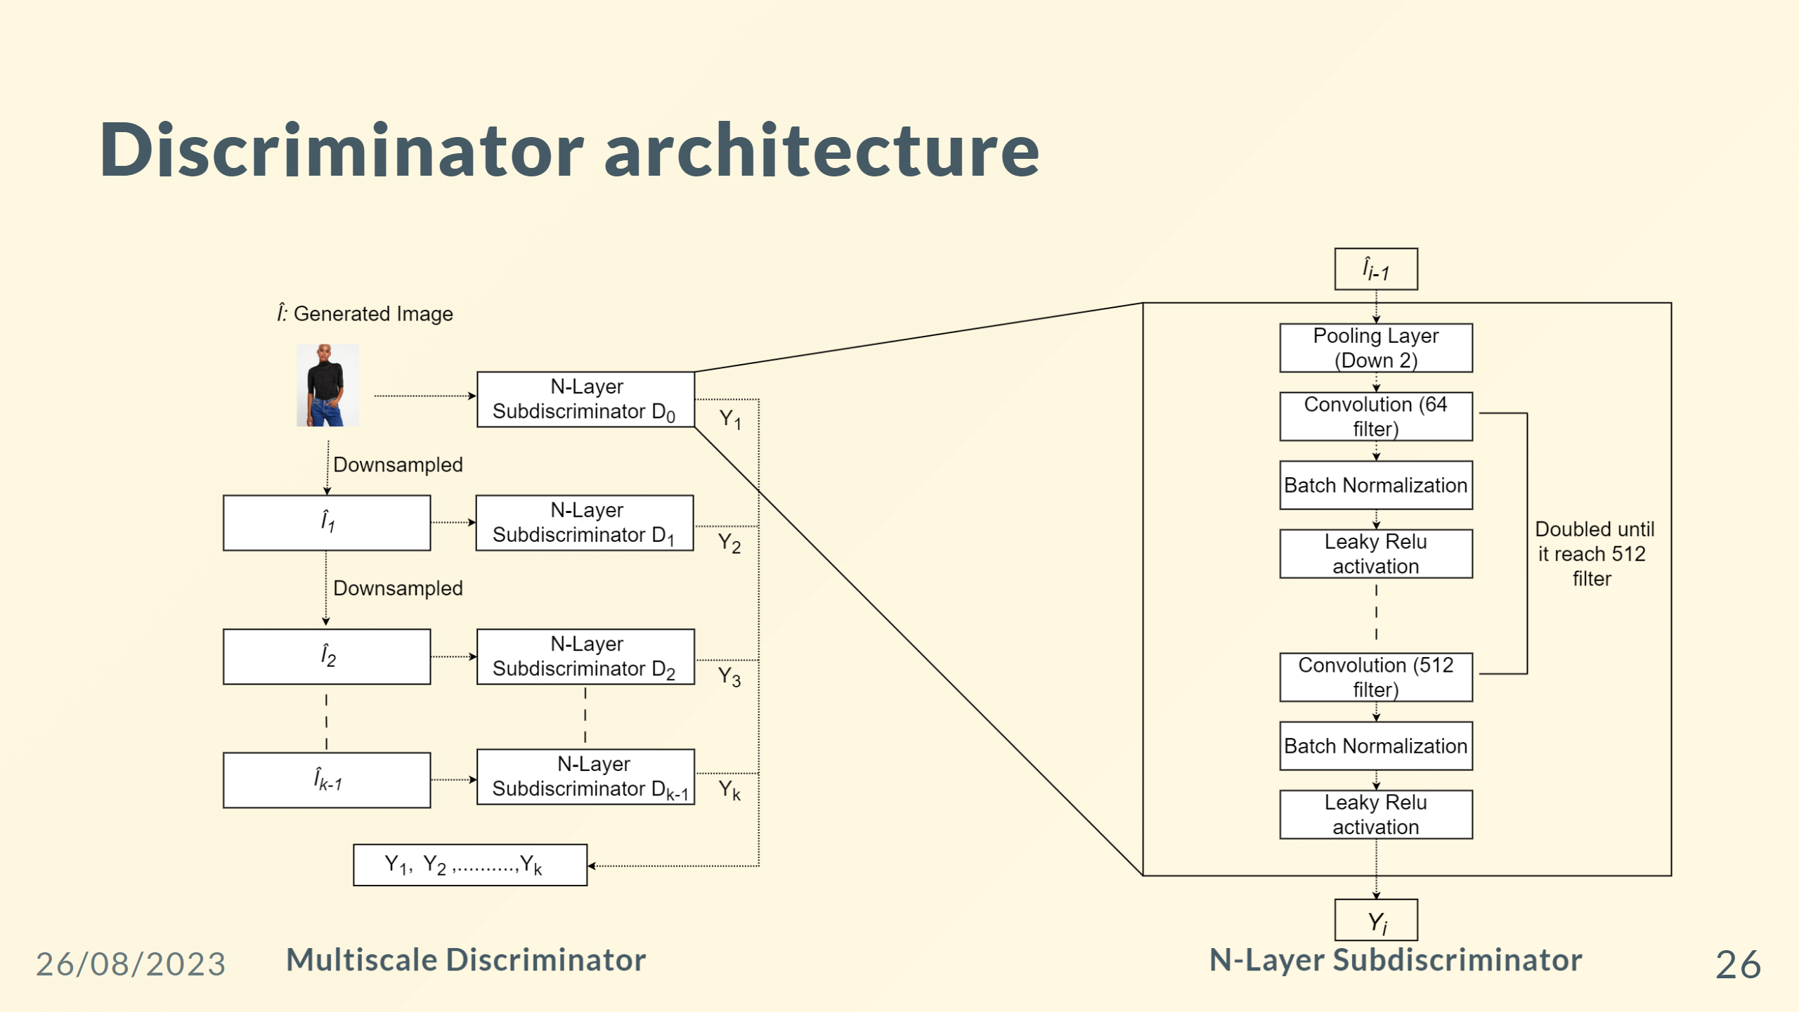

Slide 27
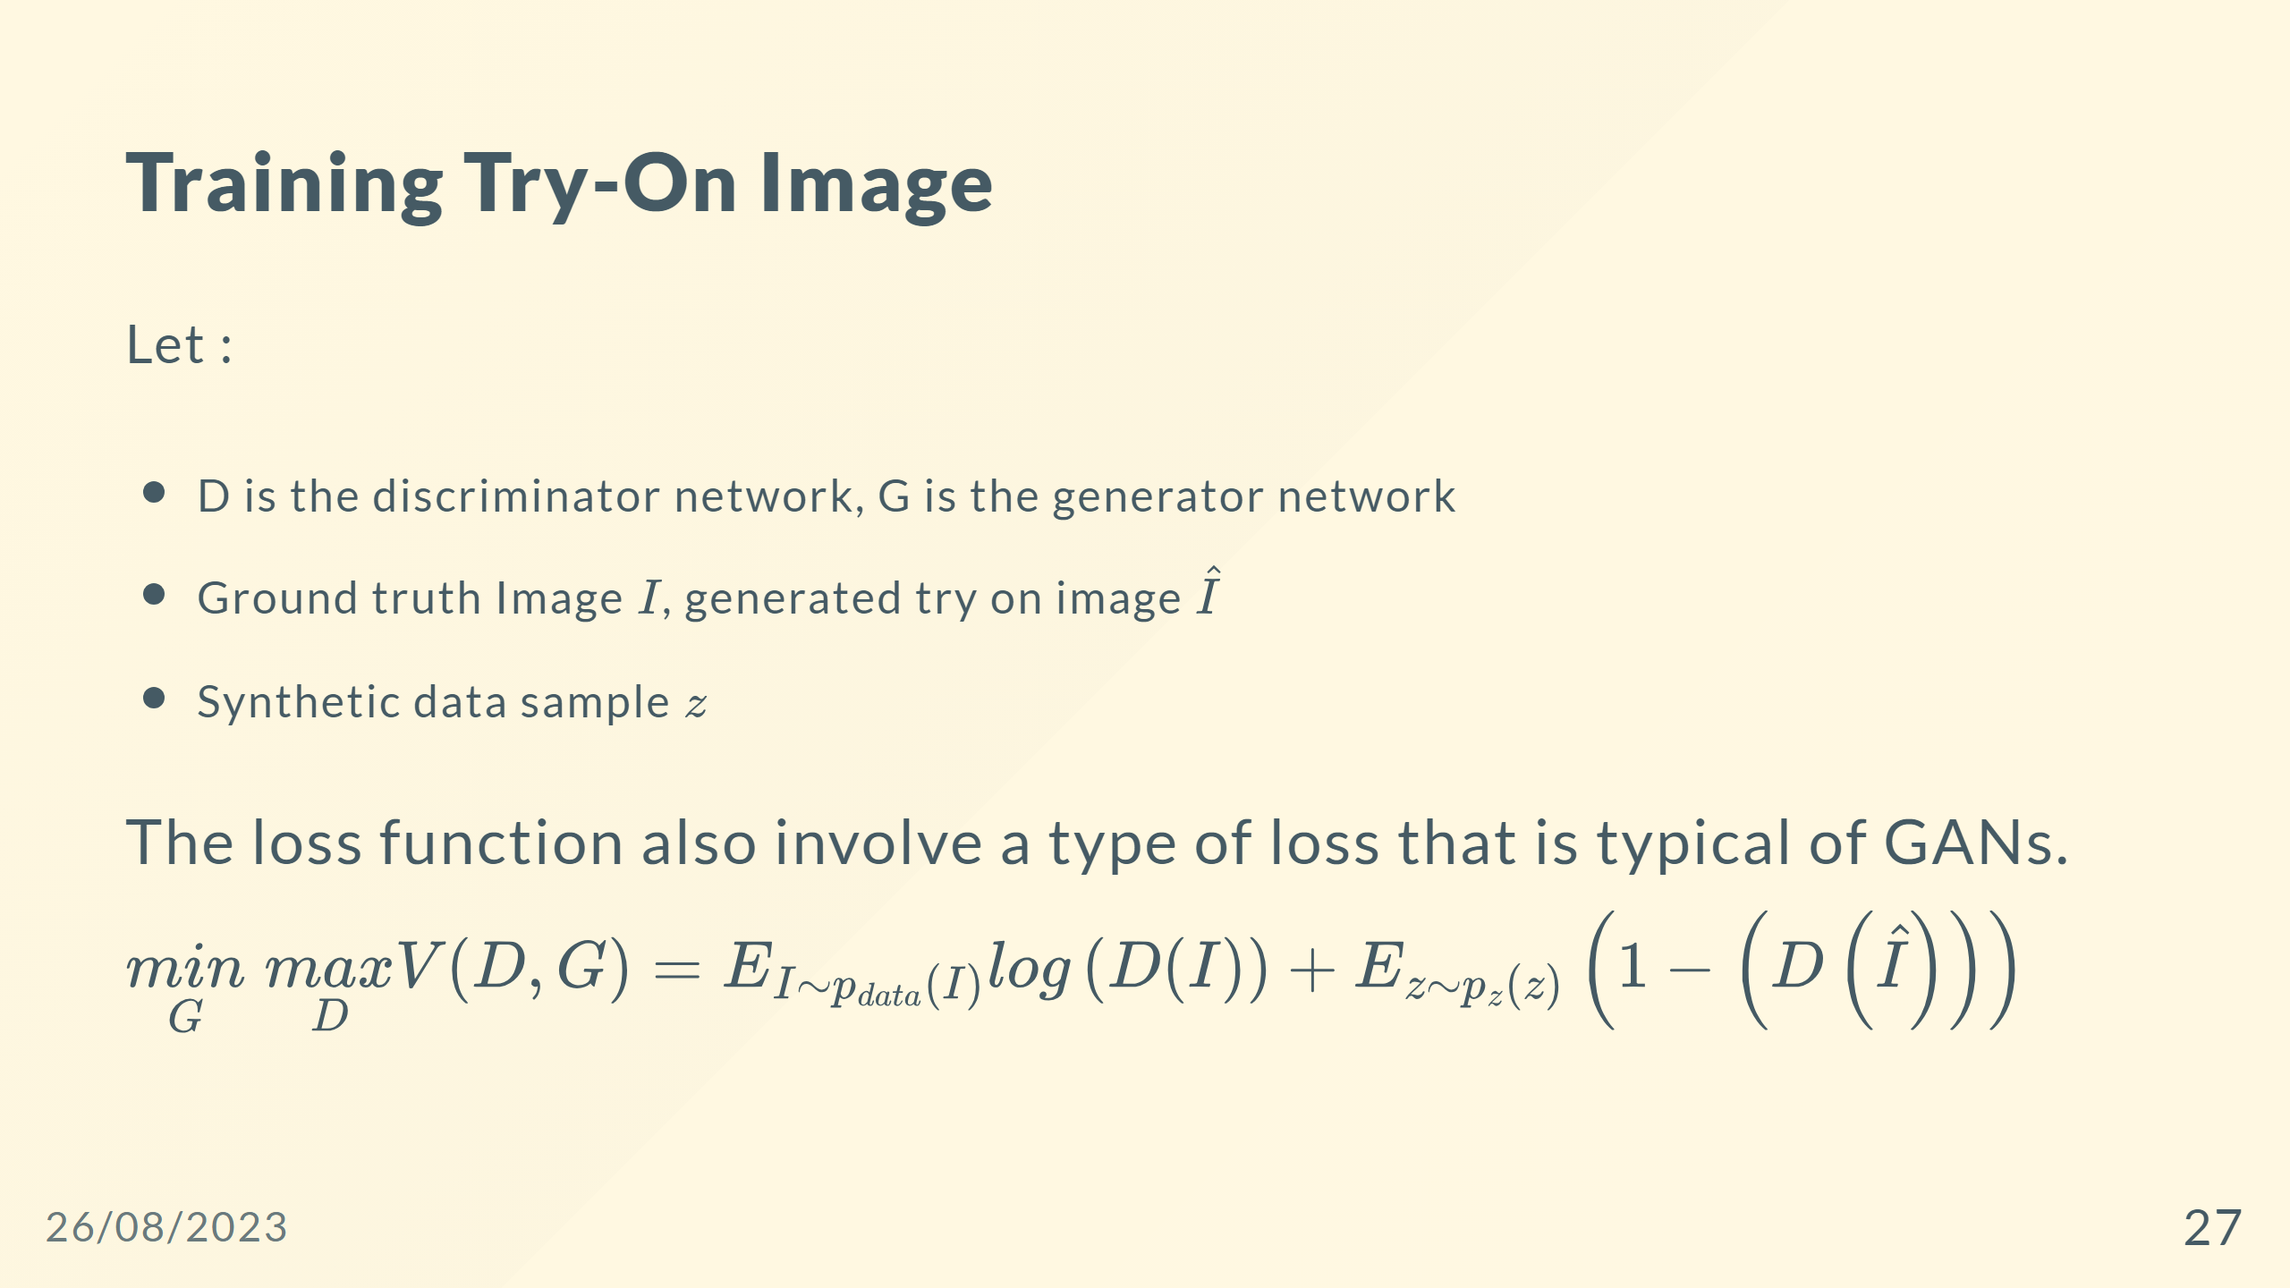

Slide 28
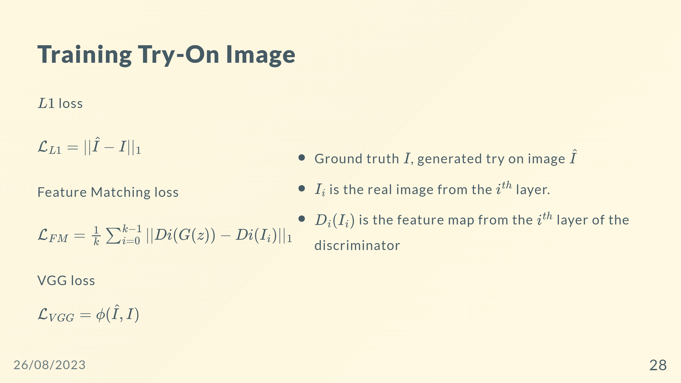

Slide 29
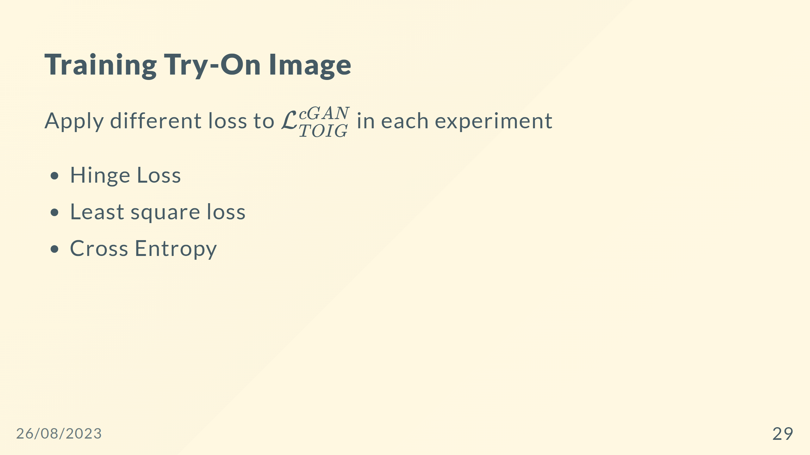

Slide 30
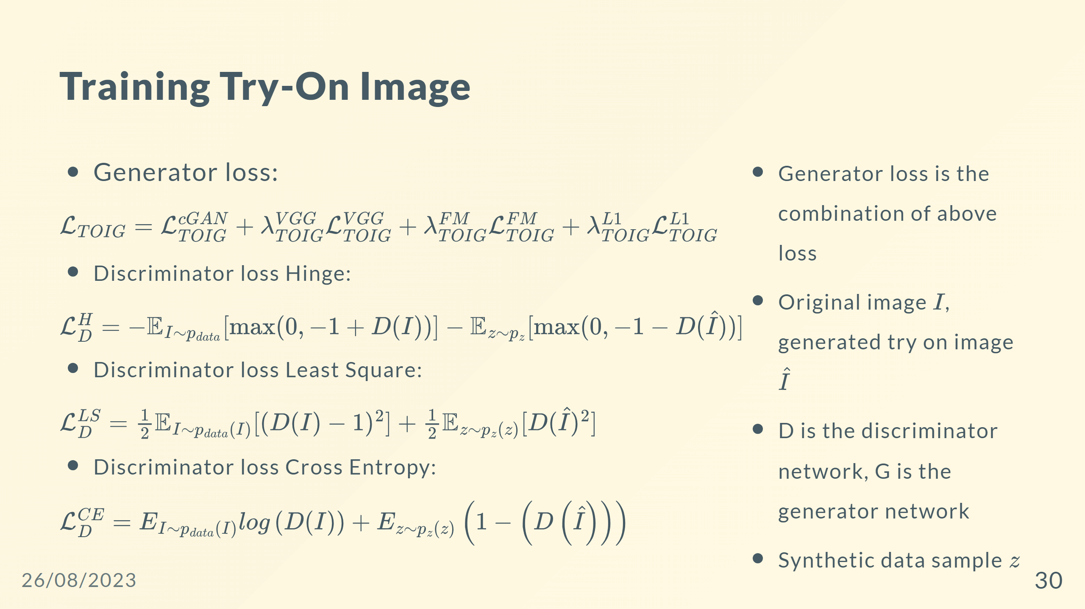

Slide 31
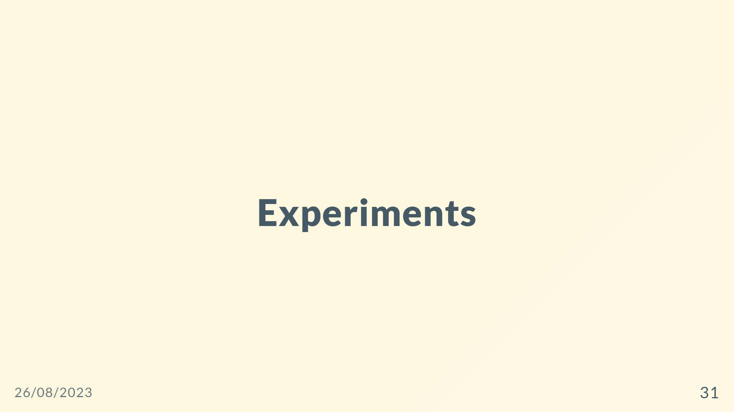

Slide 32
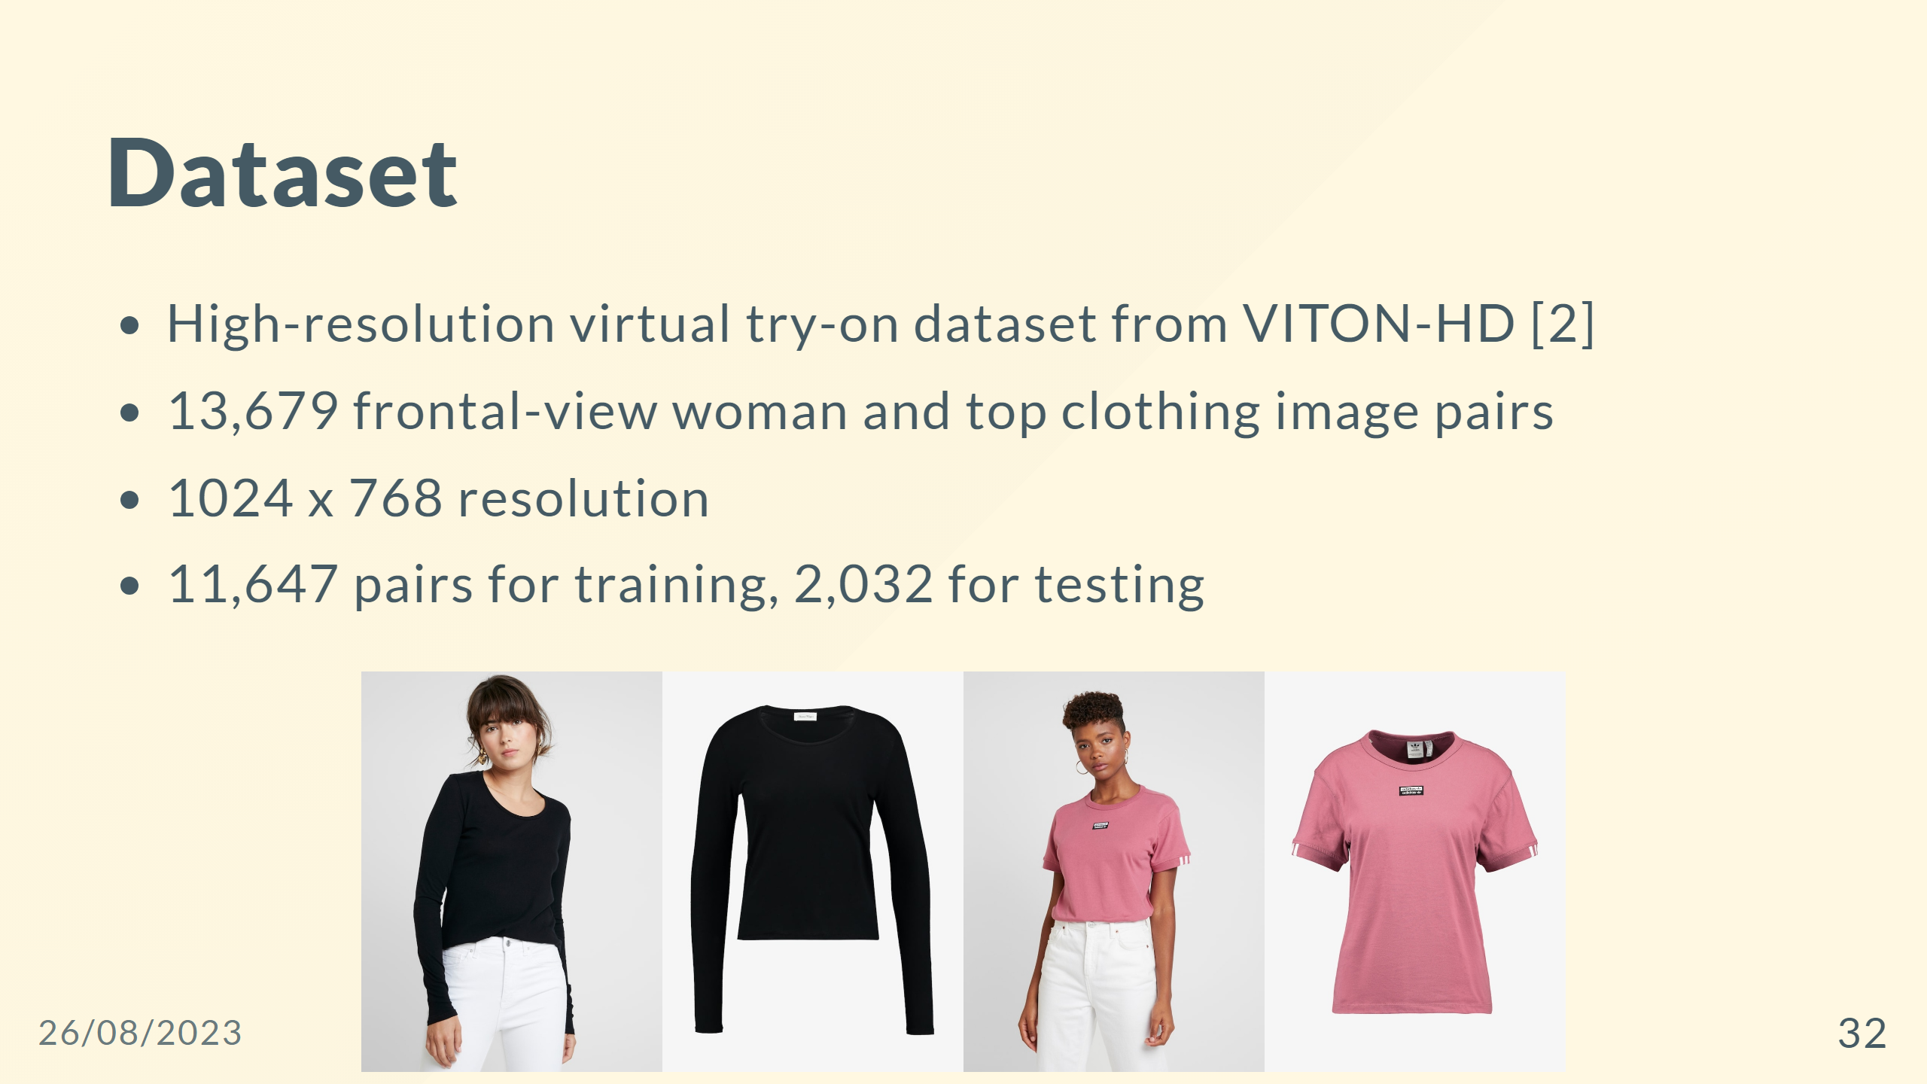

Slide 33
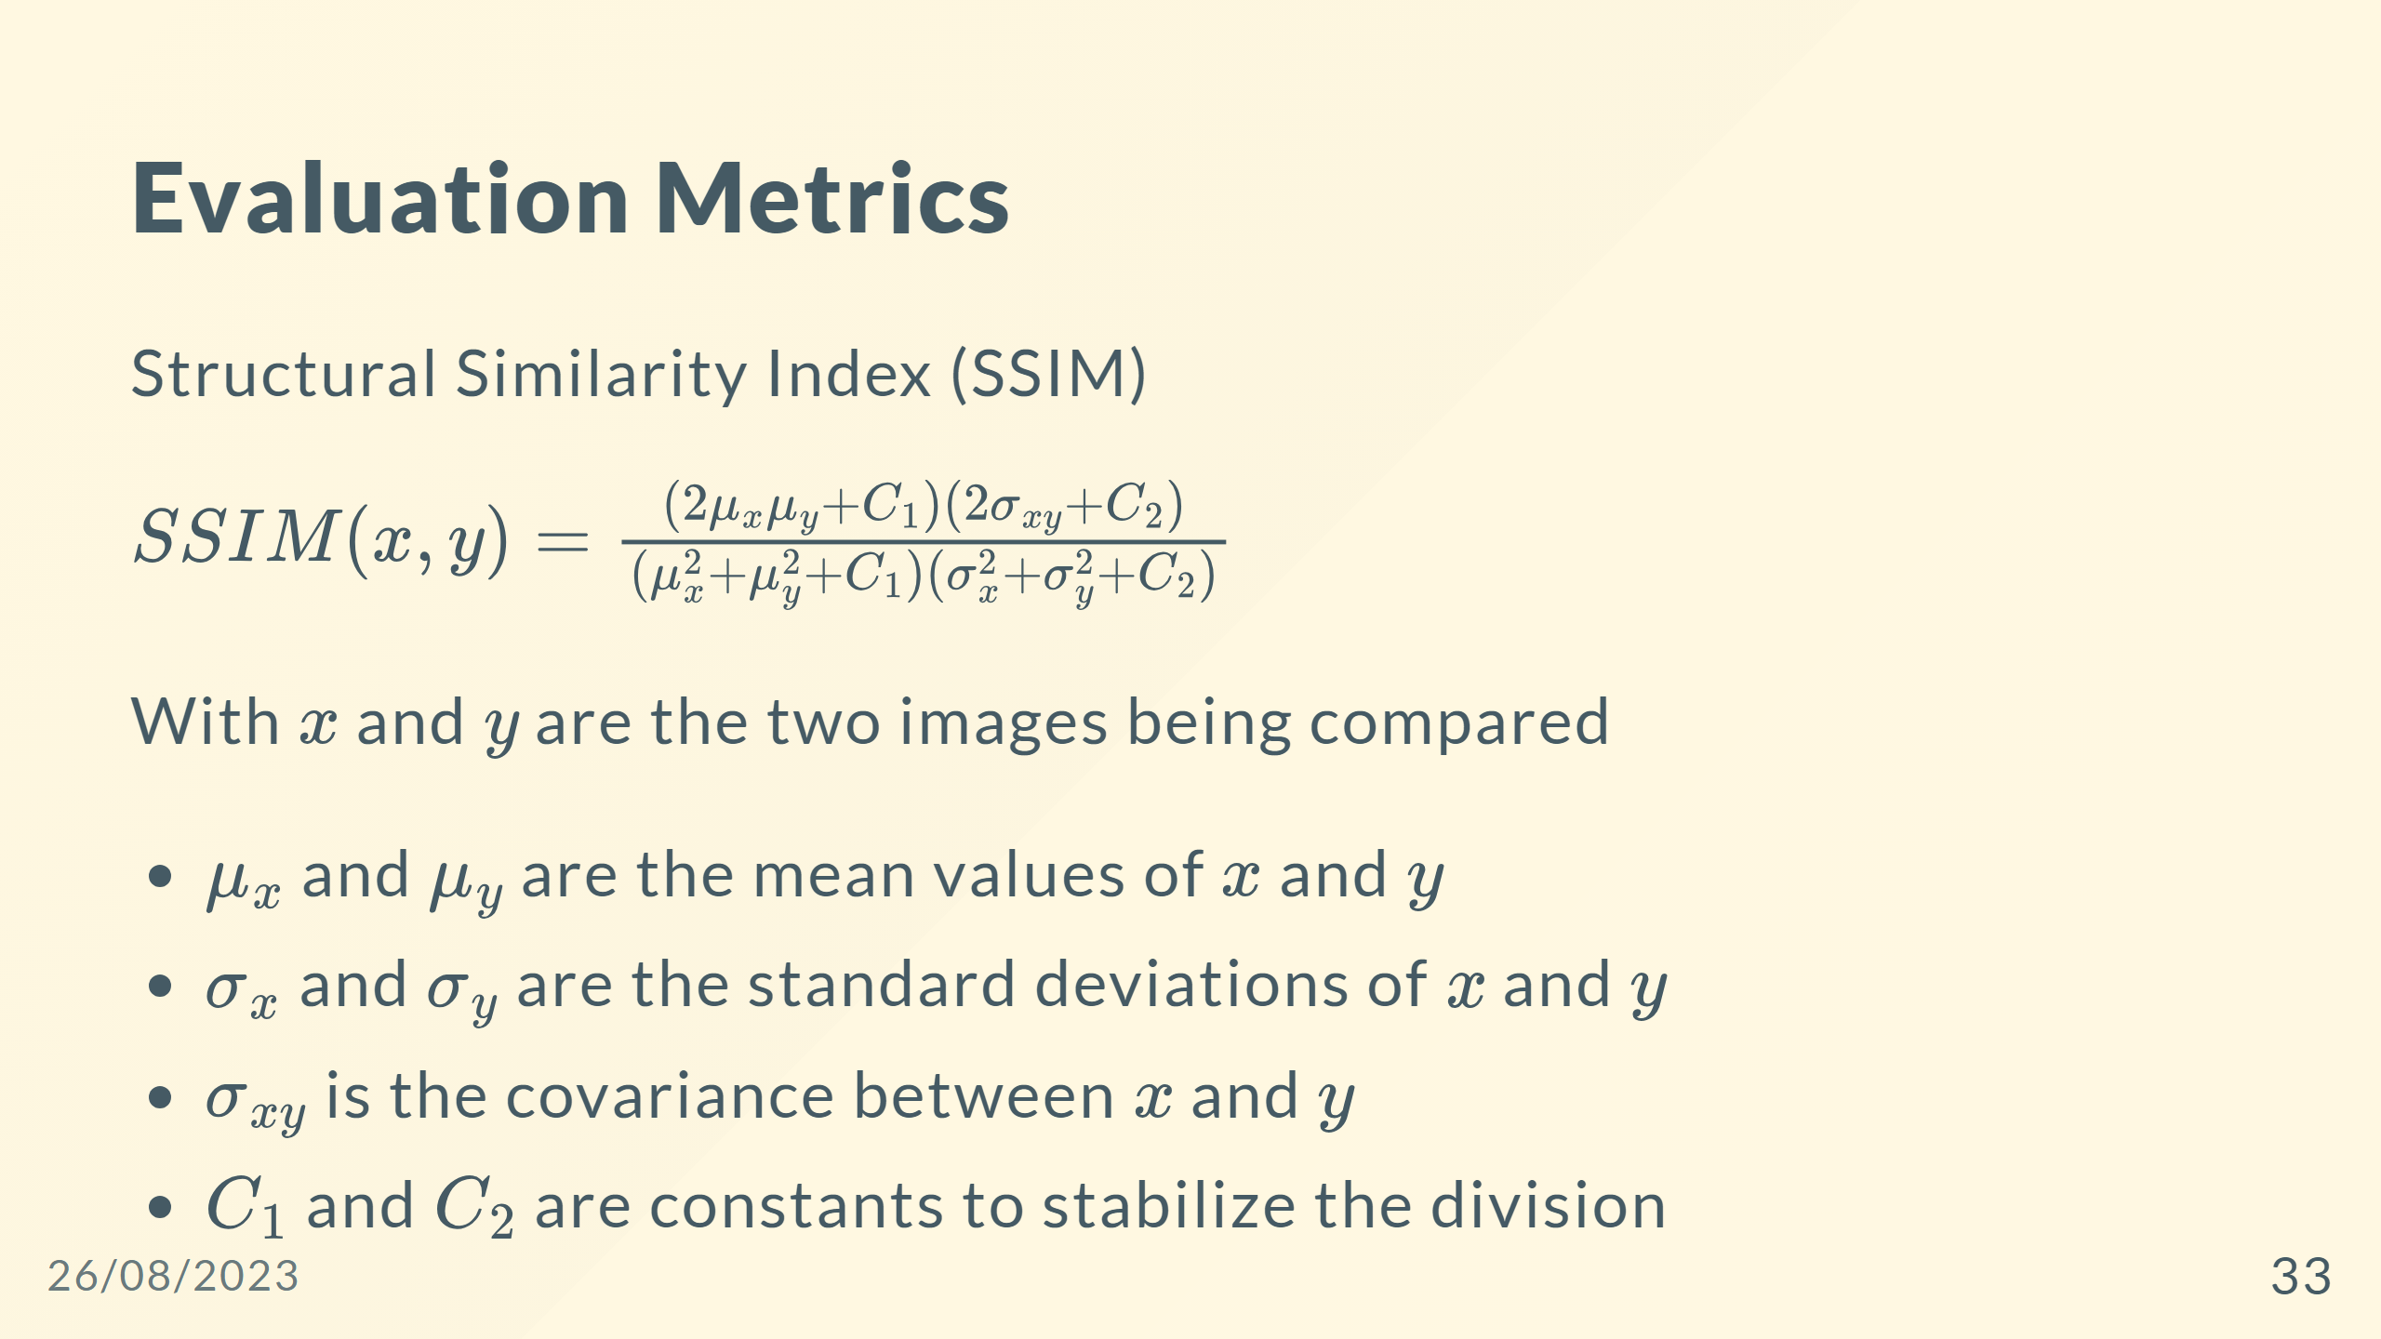
Notes:
## Evaluation Metrics - Structural Similarity Index (SSIM) $SSIM(x, y) = \frac{(2\mu_x\mu_y + C_1)(2\sigma_{xy} + C_2)}{(\mu_x^2 + \mu_y^2 + C_1)(\sigma_x^2 + \sigma_y^2 + C_2)}$ - Mean Squared Error (MSE) $MSE(x, y) = \frac{1}{n}\sum_{i=1}^{n}(x_i - y_i)^2$ - Learned Perceptual Image Patch Similarity (LPIPS) $LPIPS(x, y) = \frac{1}{N}\sum_{i=1}^{N}|f_i(x) - f_i(y)|_2$ --- ## Evaluation Metrics <div style="display:flex;flex-direction:row;"> <div style="display:flex;gap:0px;flex-direction:column;align-items:left"> <span style="font-size:30px;"> - Structural Similarity Index (SSIM) $SSIM(x, y) = \frac{(2\mu_x\mu_y + C_1)(2\sigma_{xy} + C_2)}{(\mu_x^2 + \mu_y^2 + C_1)(\sigma_x^2 + \sigma_y^2 + C_2)}$ - Mean Squared Error (MSE) $MSE(x, y) = \frac{1}{n}\sum_{i=1}^{n}(x_i - y_i)^2$ - Learned Perceptual Image Patch Similarity (LPIPS) $LPIPS(x, y) = \frac{1}{N}\sum_{i=1}^{N}|f_i(x) - f_i(y)|_2$ </span> </div> <div style="display:flex;flex-direction:column;justify-content:center;align-items:right"> <span style="font-size:30px;"> With $x$ and $y$ are the two images being compared </span> </div> </div> ---

Slide 34
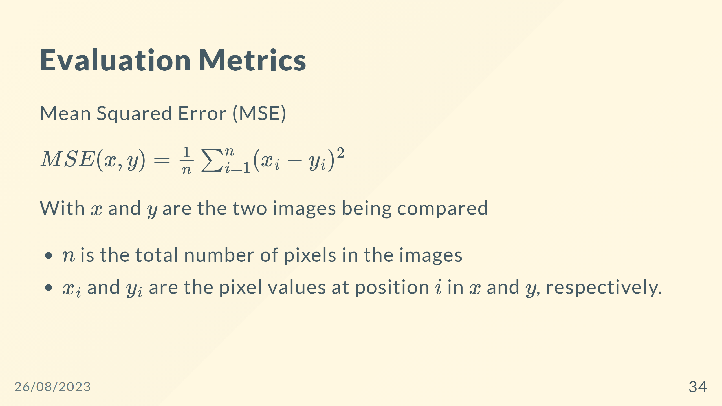

Slide 35
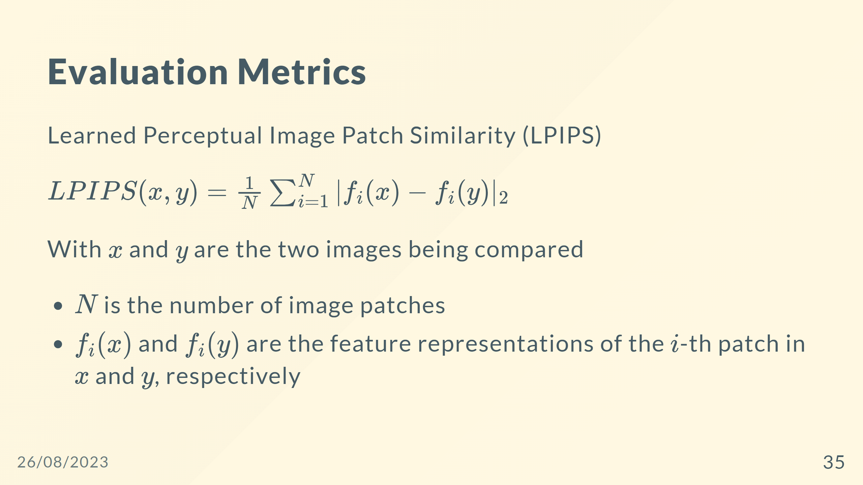

Slide 36
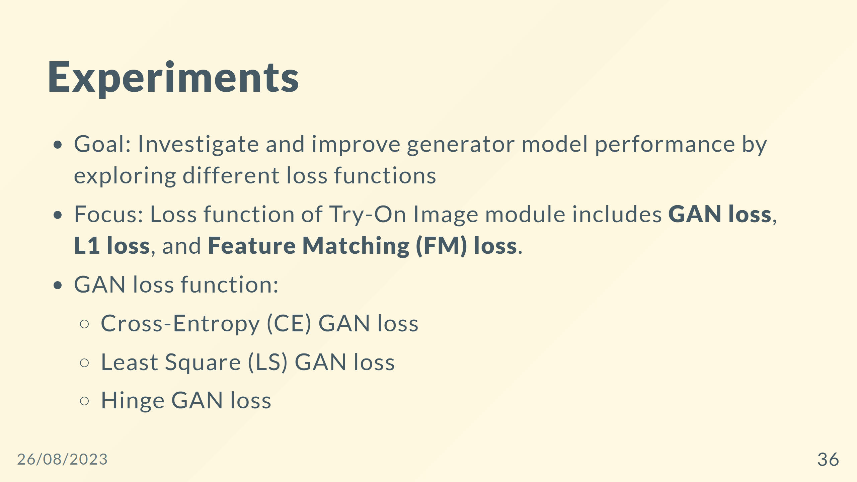

Slide 37
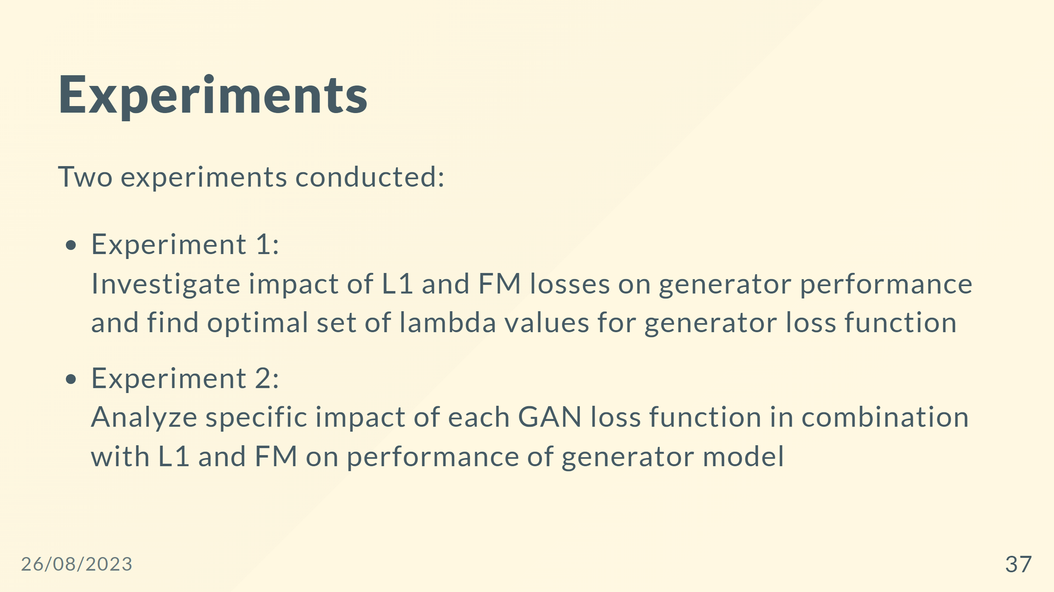

Slide 38
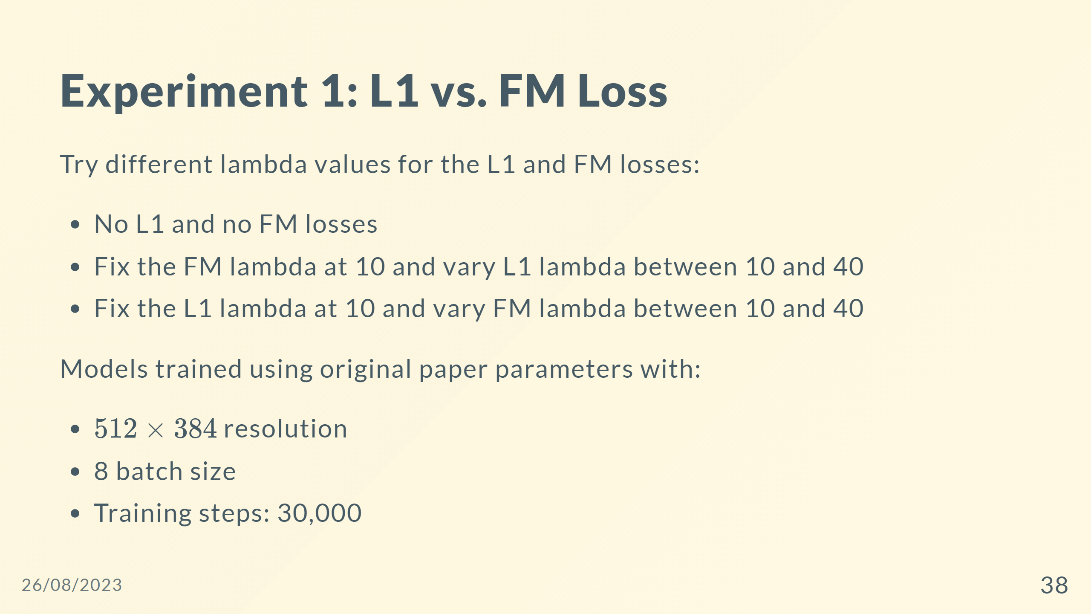

Slide 39
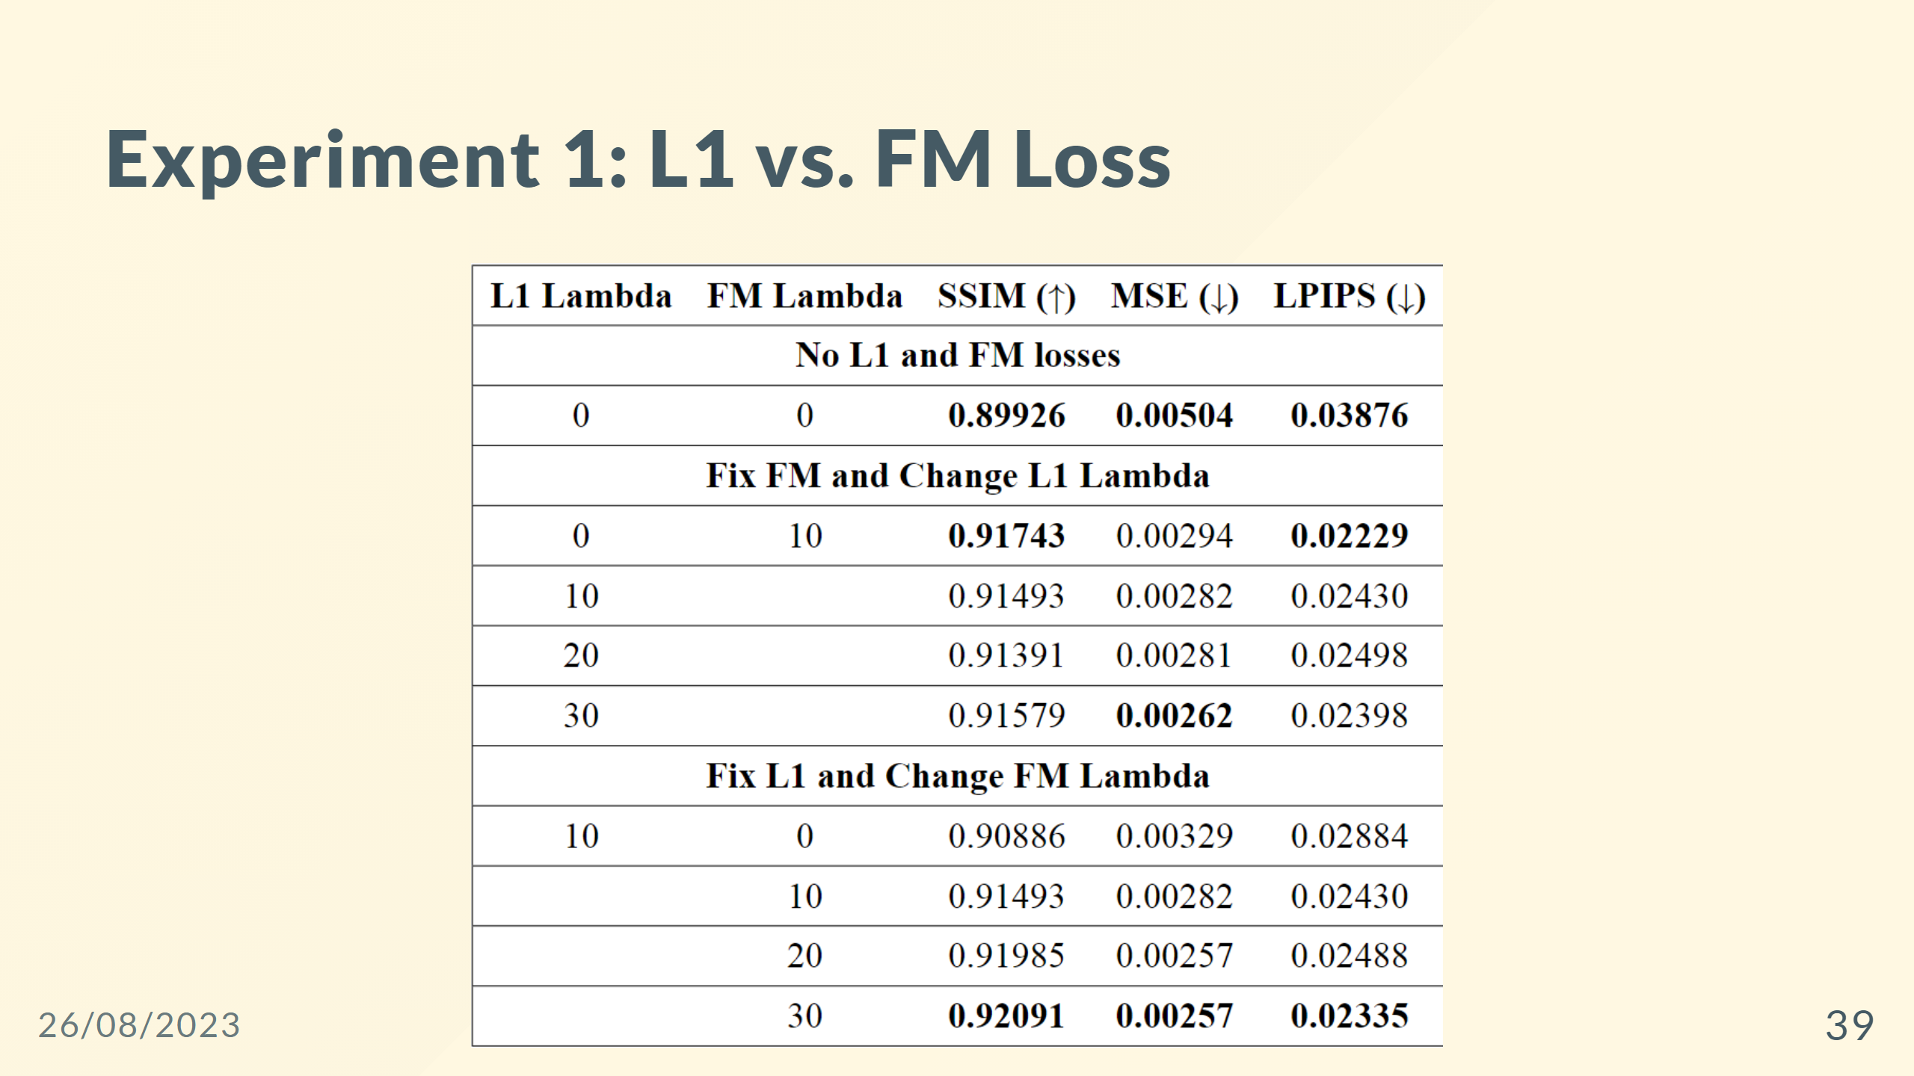

Slide 40
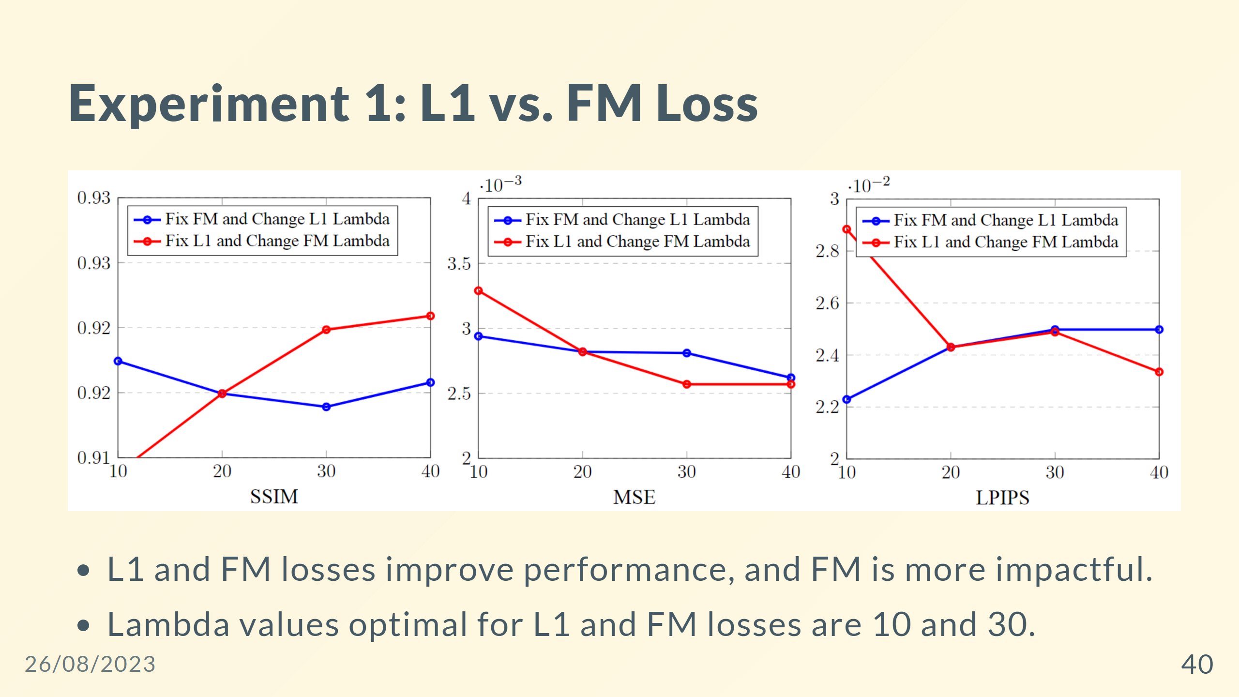

Slide 41
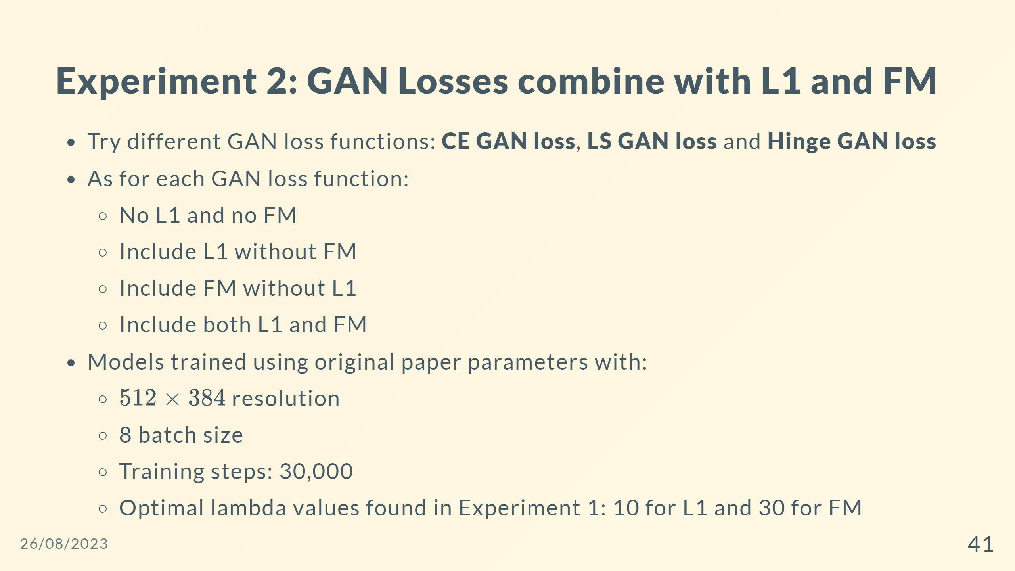

Slide 42
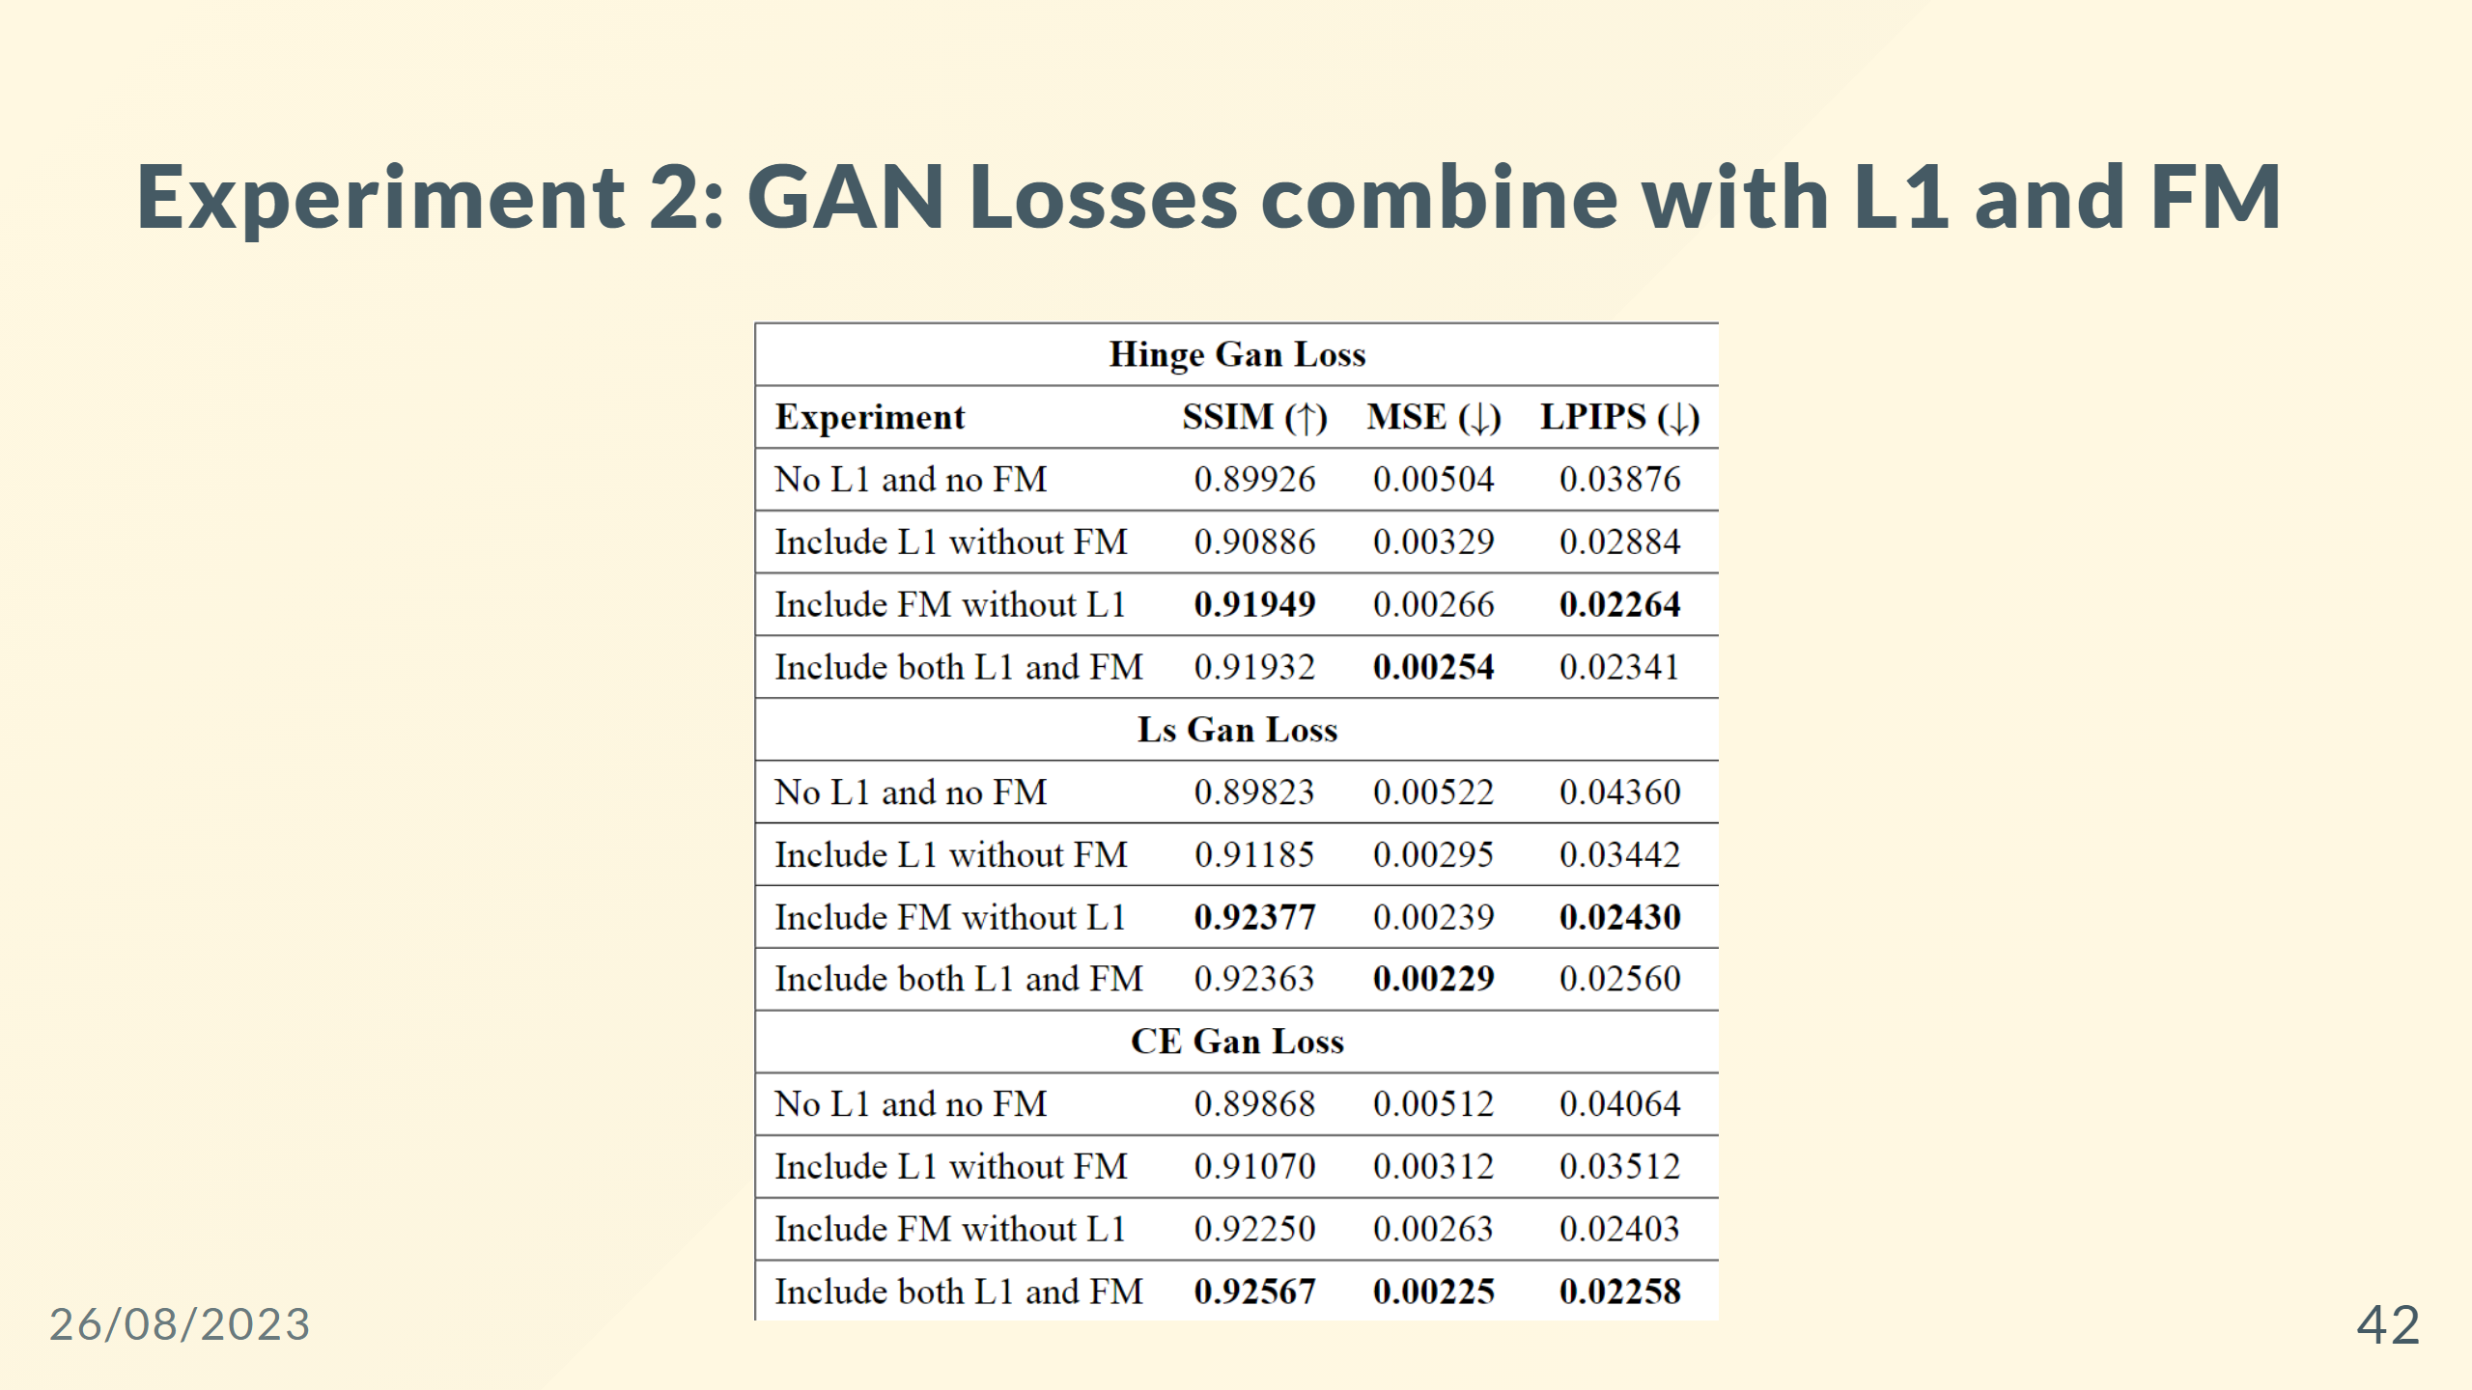

Slide 43
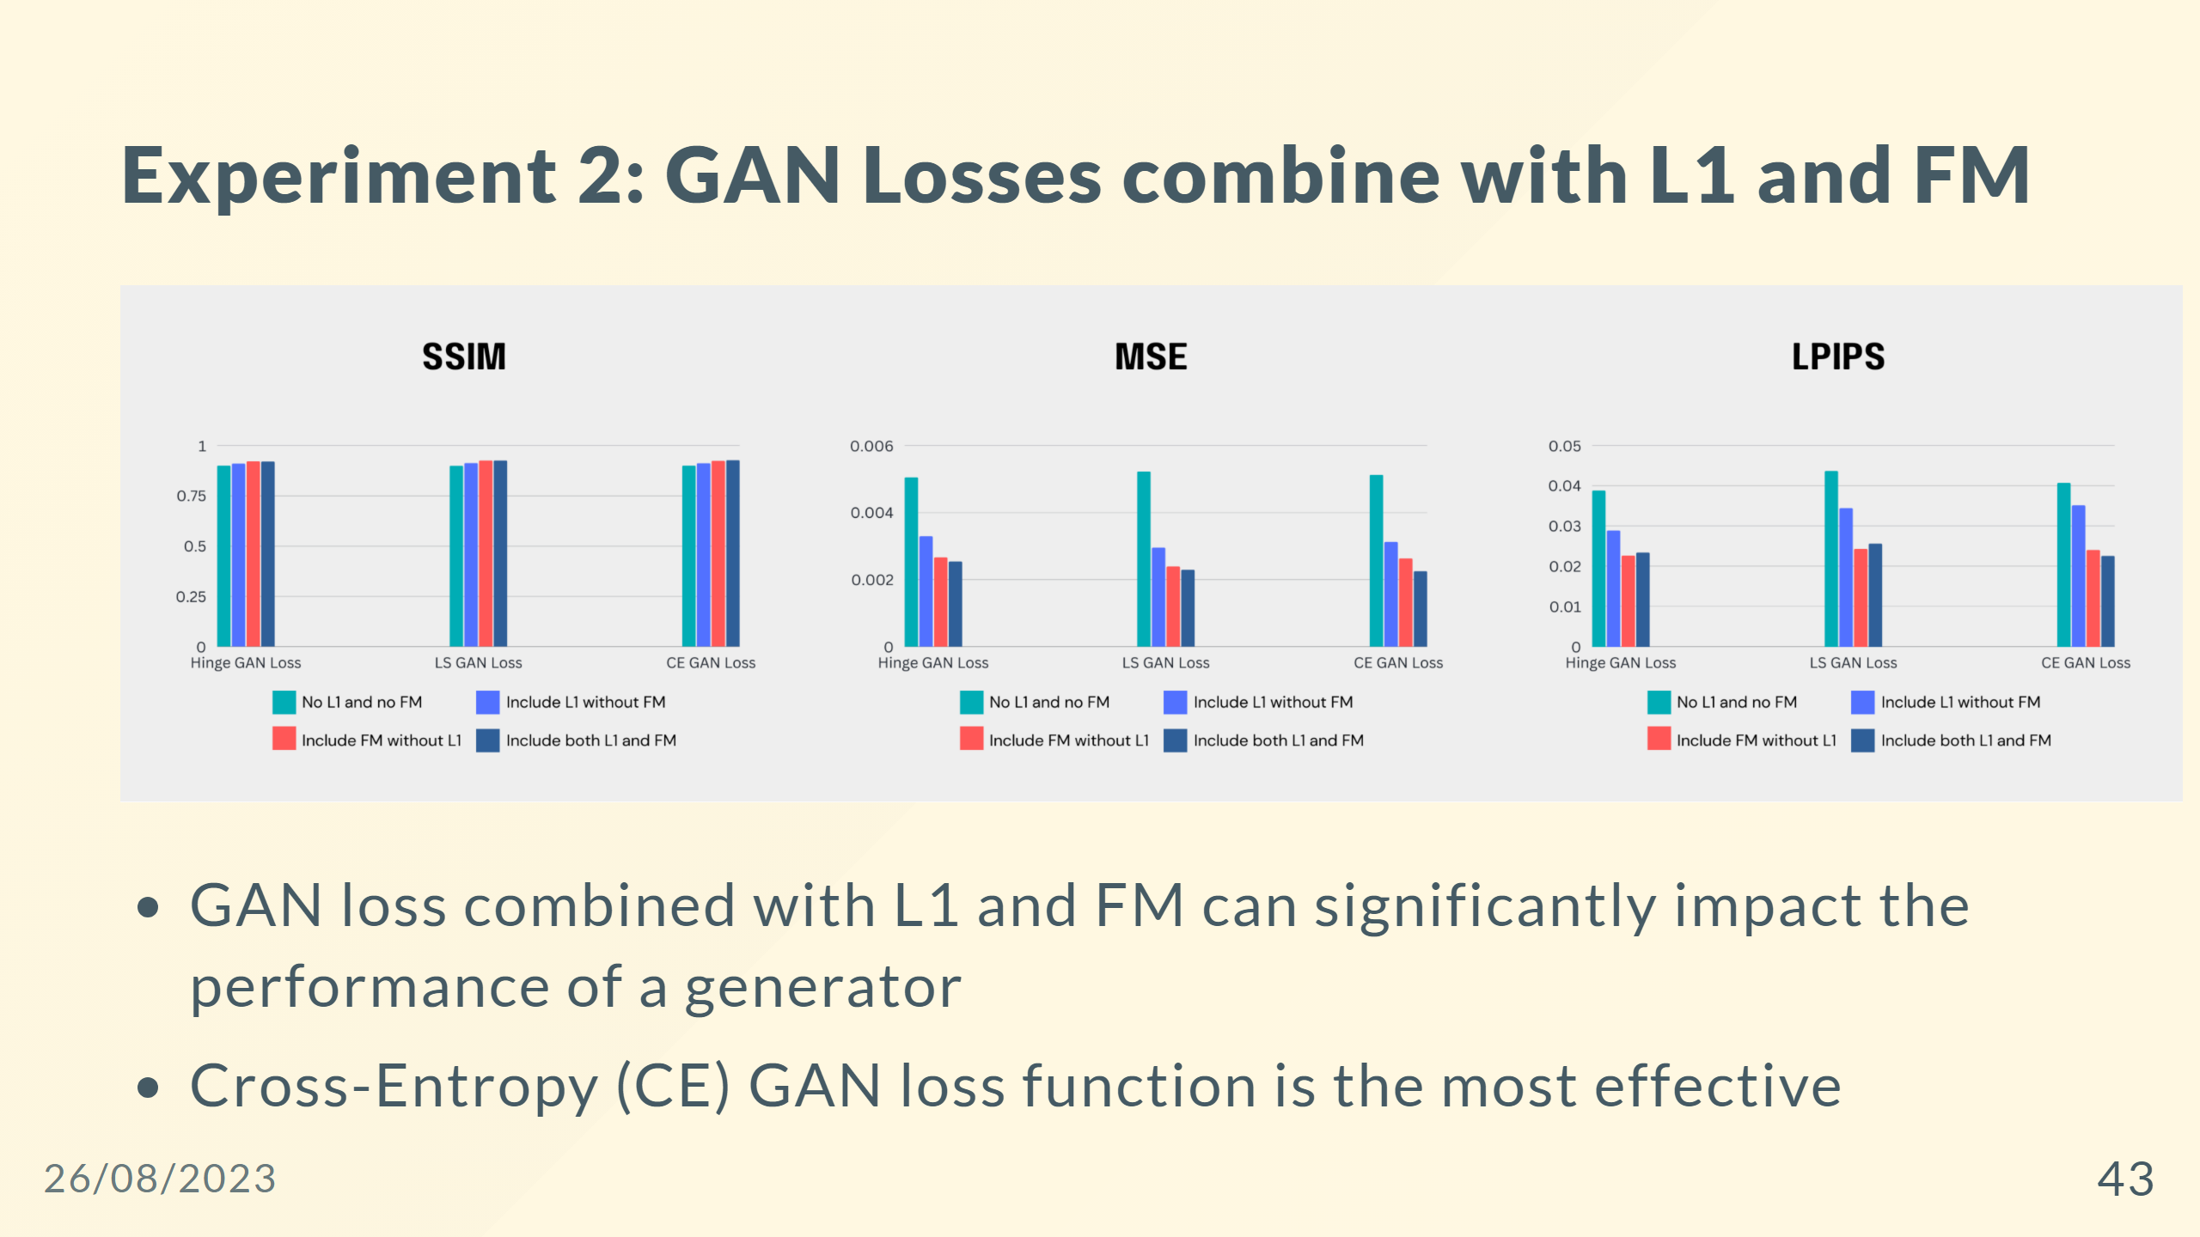

Slide 44
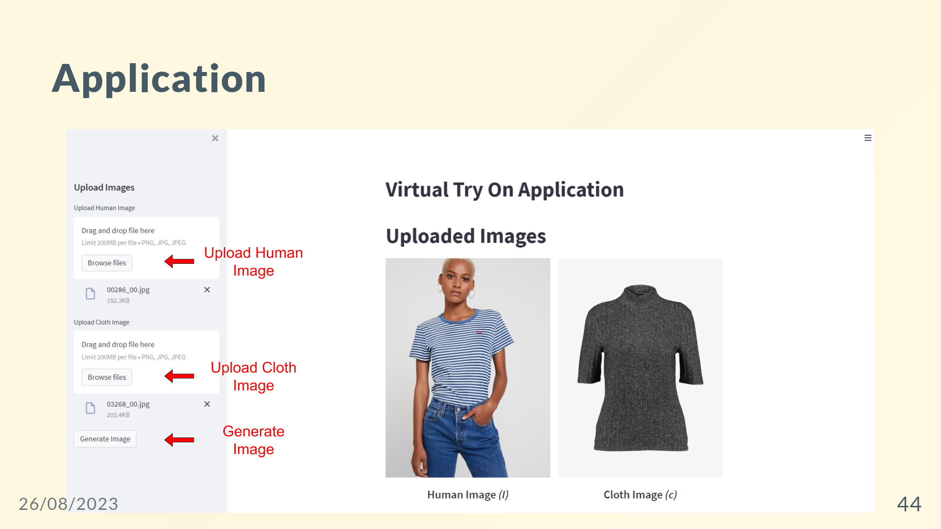

Slide 45
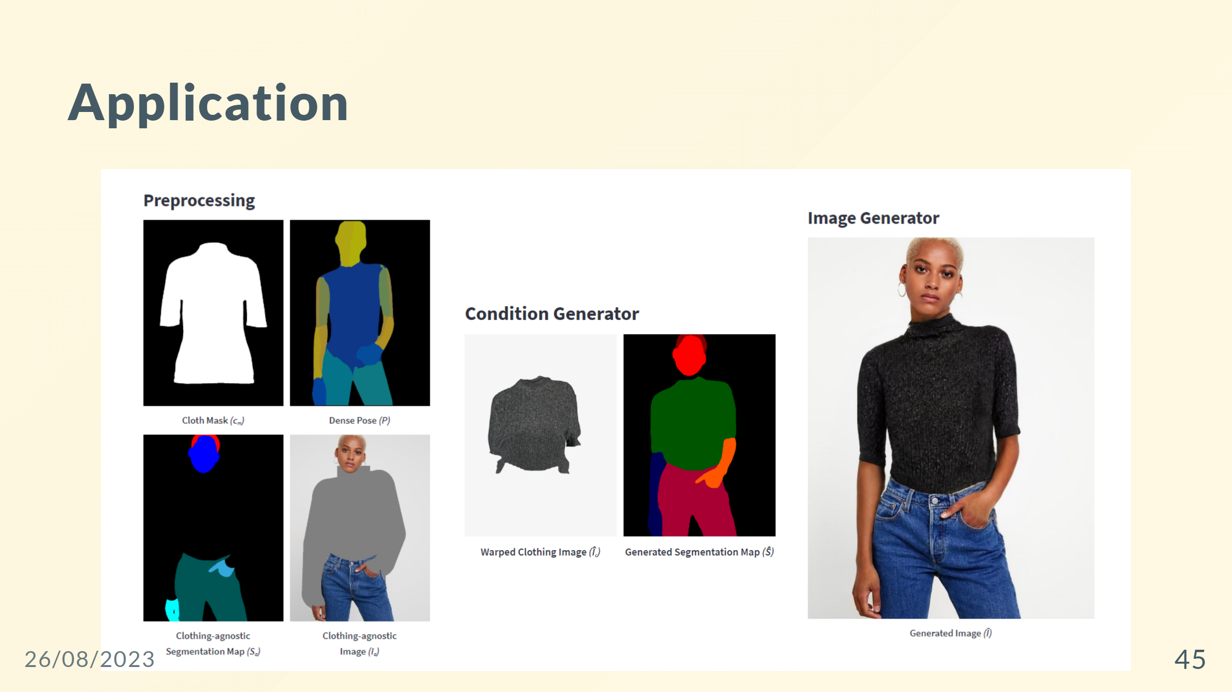
Notes:
--- ## Application Overview - Architecture: Microservice - Programming language: Python - Communication between services: gRPC - User interface: Streamlit - Deploy: Docker ![width:900 centernotop](app-overview.png)

Slide 46
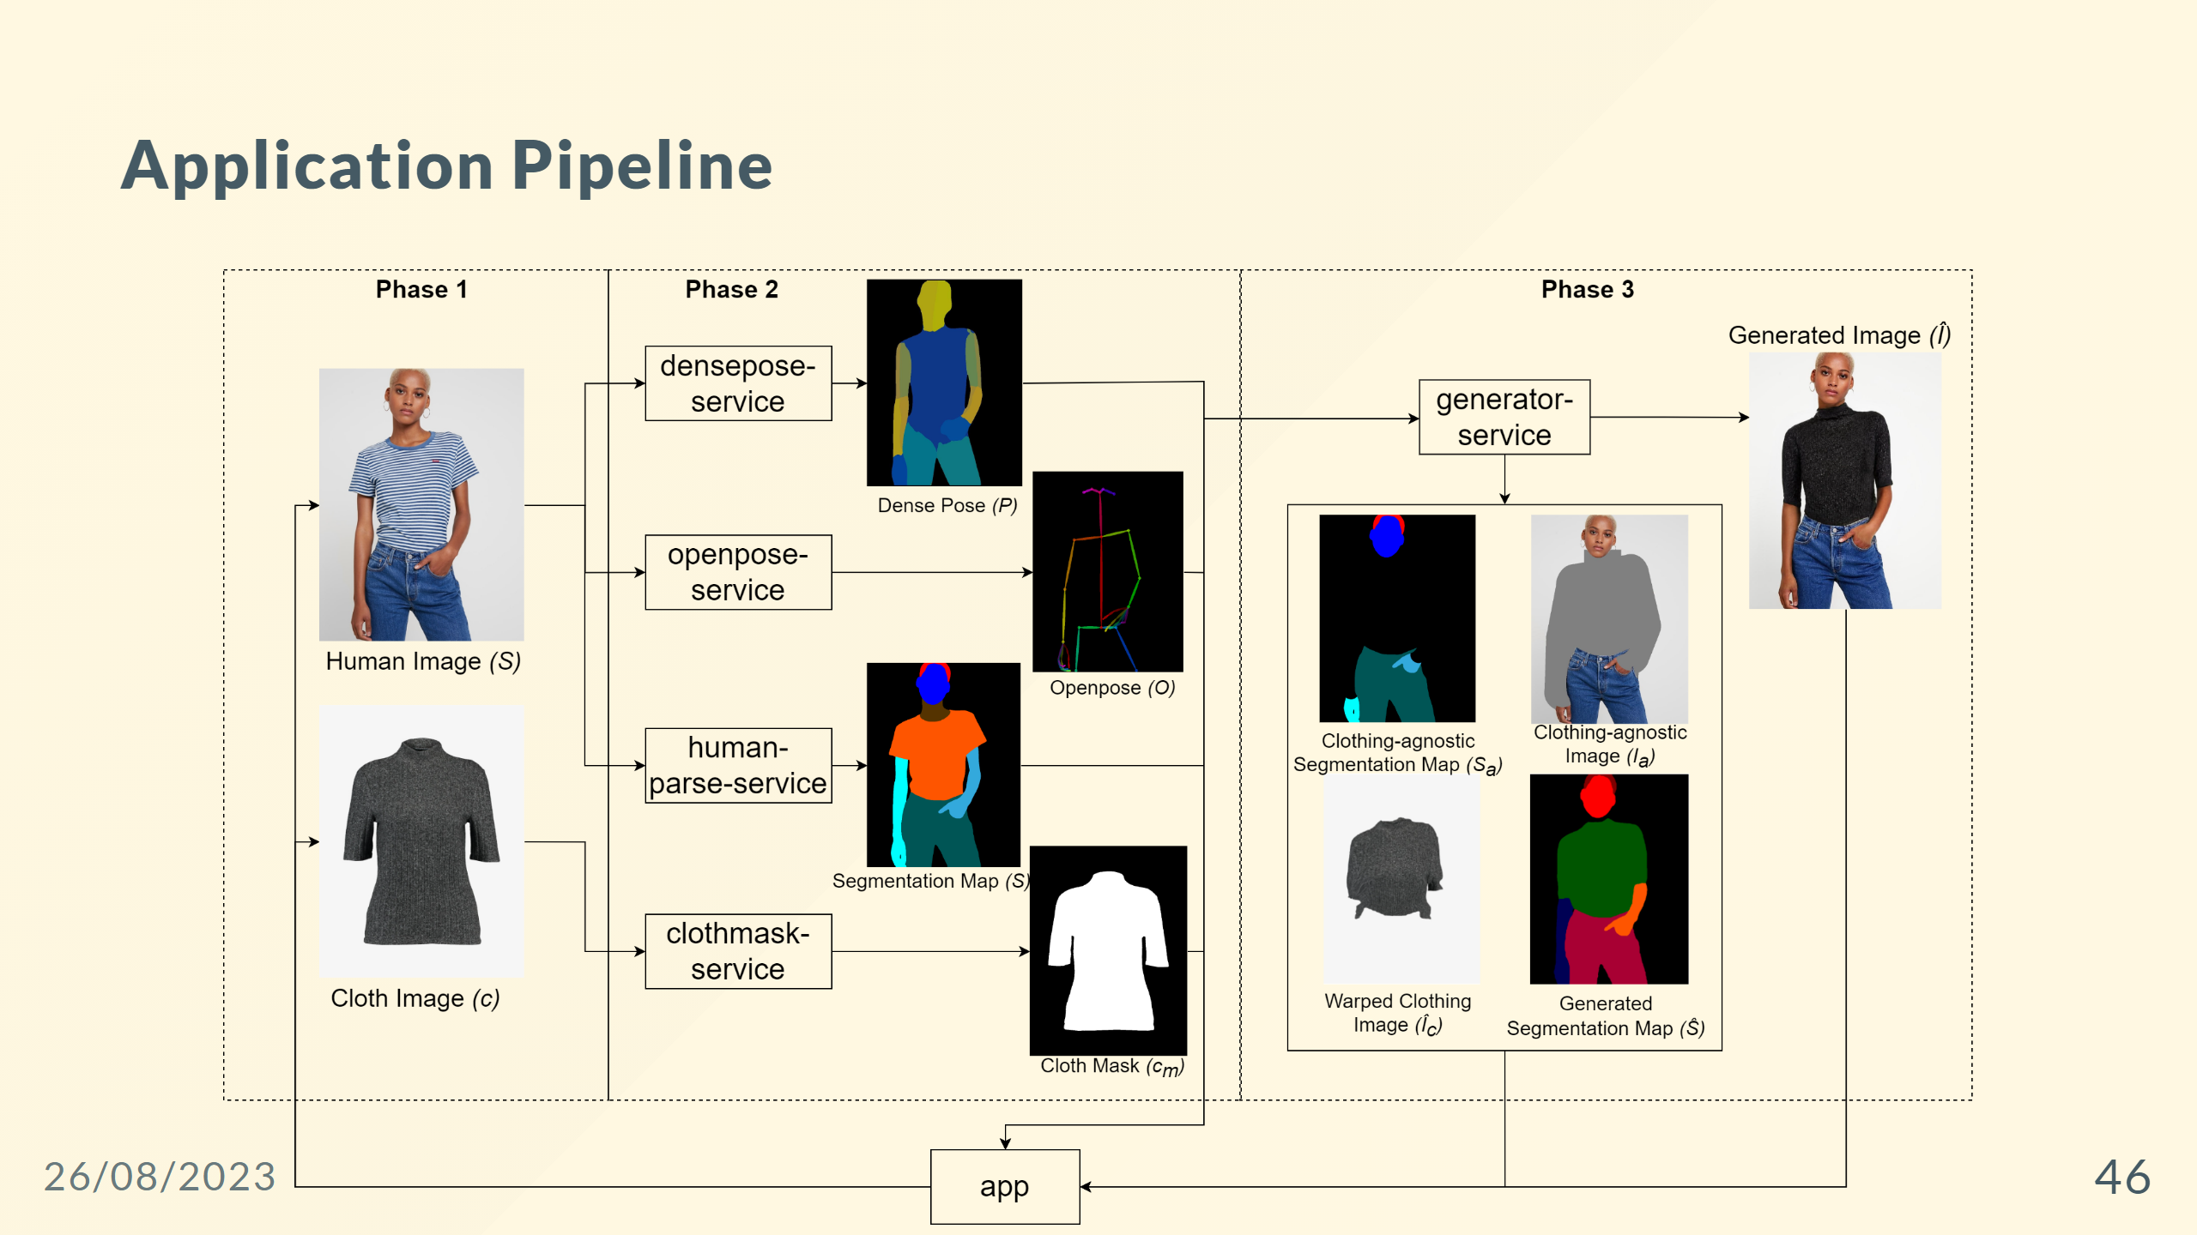

Slide 47


Slide 48
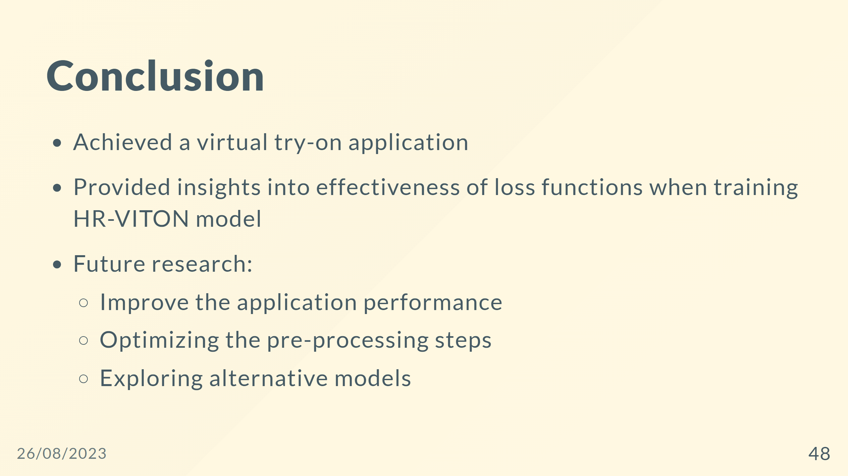

Slide 49
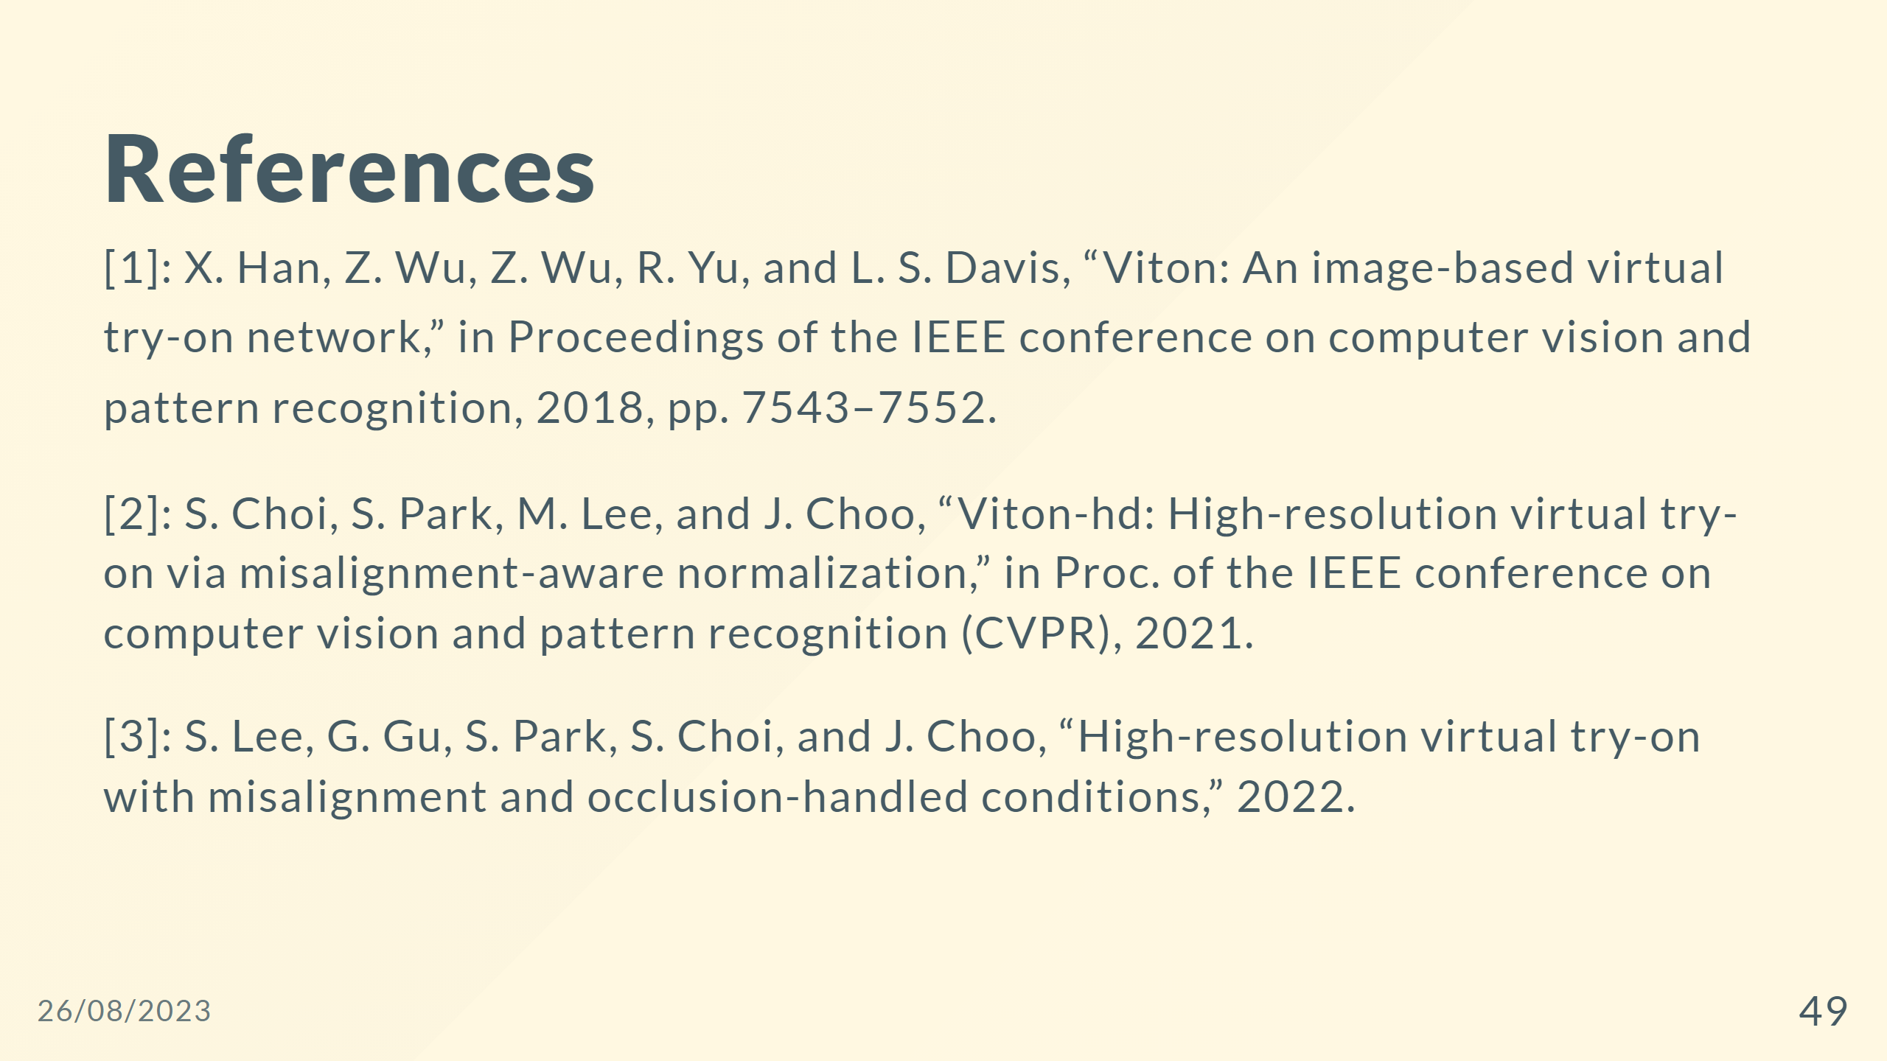

Slide 50
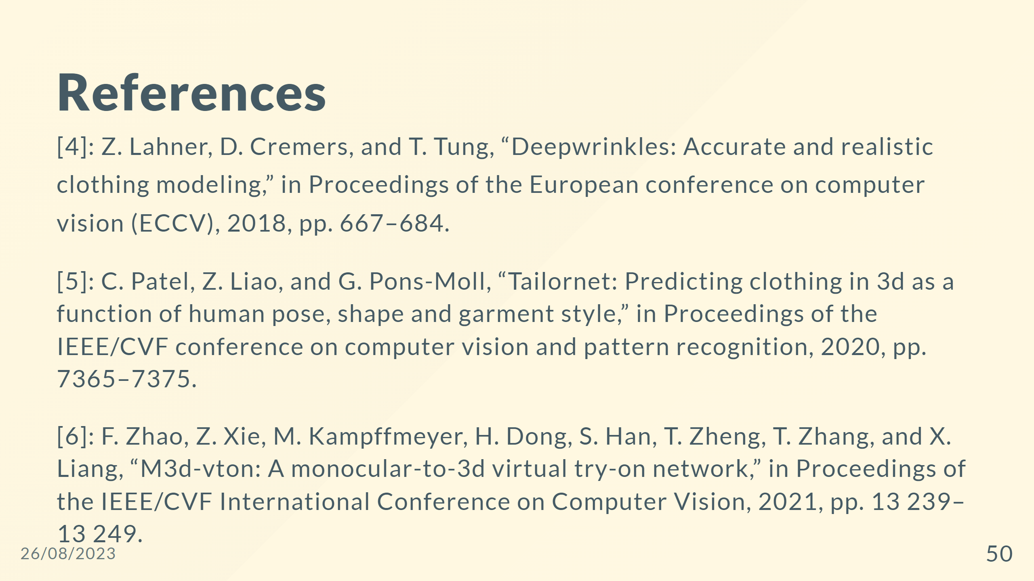

Slide 51
